Slide 1
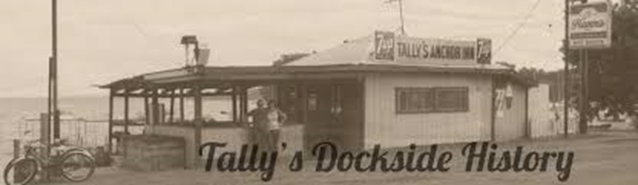
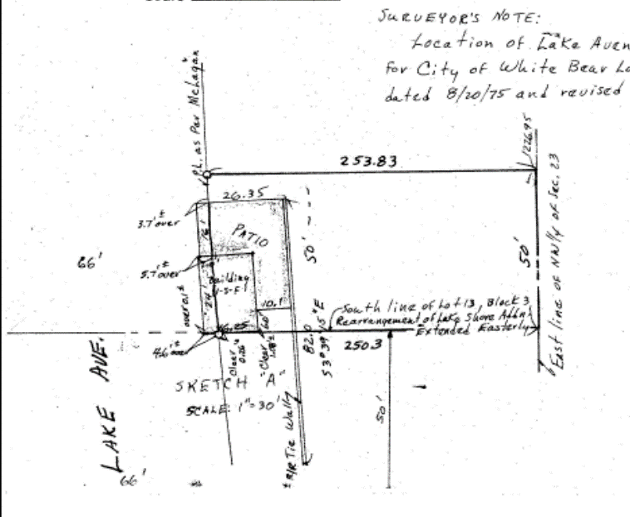
In 1983, under the ownership of Ralph and Marie Blomer, the property on which the current structure is located was registered through the Torrens process, resulting in title to the lakeside property as follows: the south 40 feet of the east 70 feet of Lot 12, Block 3 “Rearrangement of Lake Shore Addition to White Bear, Minn”, not including accretions and riparian rights on the east side of Lake Avenue, and the east 70 feet of adjoining Lot 13, including the accretions and riparian rights east of Lake Avenue.

Slide 2
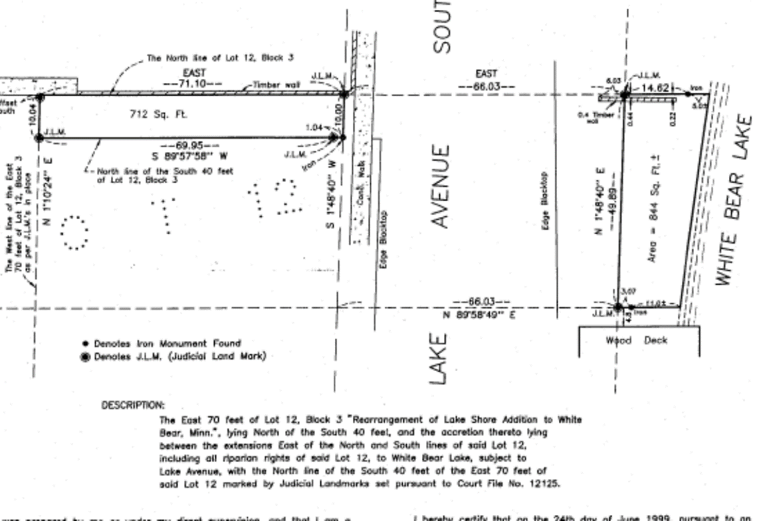

Slide 3
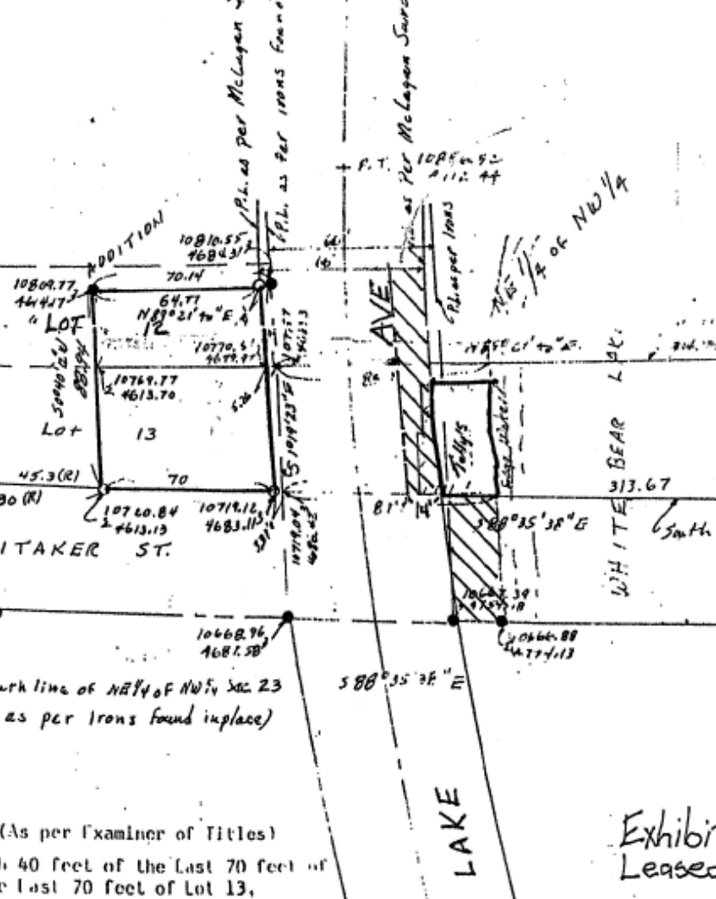
1999: Tally’s Dockside formalized historic use of the Whitaker street end through a lease with the City to continue its fuel service.
2000: Lease was amended in 2000 to include 14 x 100 feet of Lake Avenue, east of City’s bike path.
2005: Lease was amended to increase rent to $375/month and increase insurance coverage
2006: Lease again amended to reduce rent to $100/month

Slide 5
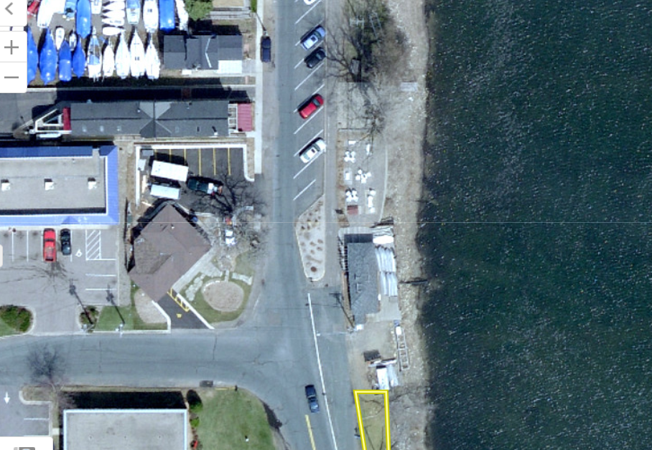

Slide 6
1889 Plat:
  Subject to easements for public road purposes……as to that part of said Lake Avenue lying West of a line parallel to and 66 feet East from the East line of said Lot.
  Subject to easements for water and sewer main purposes…..66 feet east….

Slide 7
Assumptions applied:
  Continued presence of fuel service available on the lake for boaters;
  Rent/lease structure that acknowledges value of public’s right-of-way, balanced with reasonable expectations for a rate of return on private enterprise;
  Removal of all structures, equipment and items from street end property not directly related to fuel service, (i.e. signage, porta-potties, shed, et al)
  Use income approach in development of rent structure in consideration of fuel service only.

Slide 13
Recommended Provisions of Lease:
Permitted use for fuel service related structures, equipment, et al; removal of other structures, signs, et al
Placement of fence around the tank to effectively block street view and as approved by the City shall be erected and maintained
Effective January 1, 2019
20 year lease; may be terminated upon nine (9) months notice by action of the Council for an alternative public purpose
Increased insurance requirements:
  Commercial General Liability to $2,000,000 per occurrence
  Pollution Liability policy - $1,000,000 (gas leak clause also added)
  Workers’ Comp policy $1M/$1M Part B coverage
Rent at 5% of gross profit (annual fuel sales less cost of fuel)

Slide 15
