Slide 1
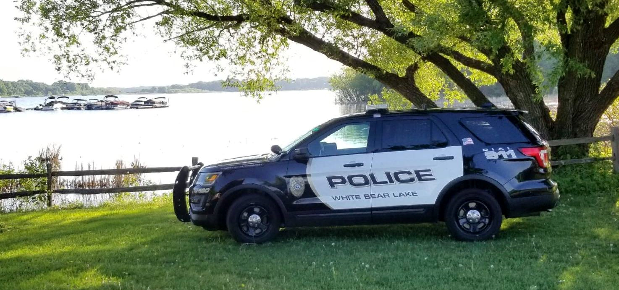
White Bear Lake Police Department

Slide 2
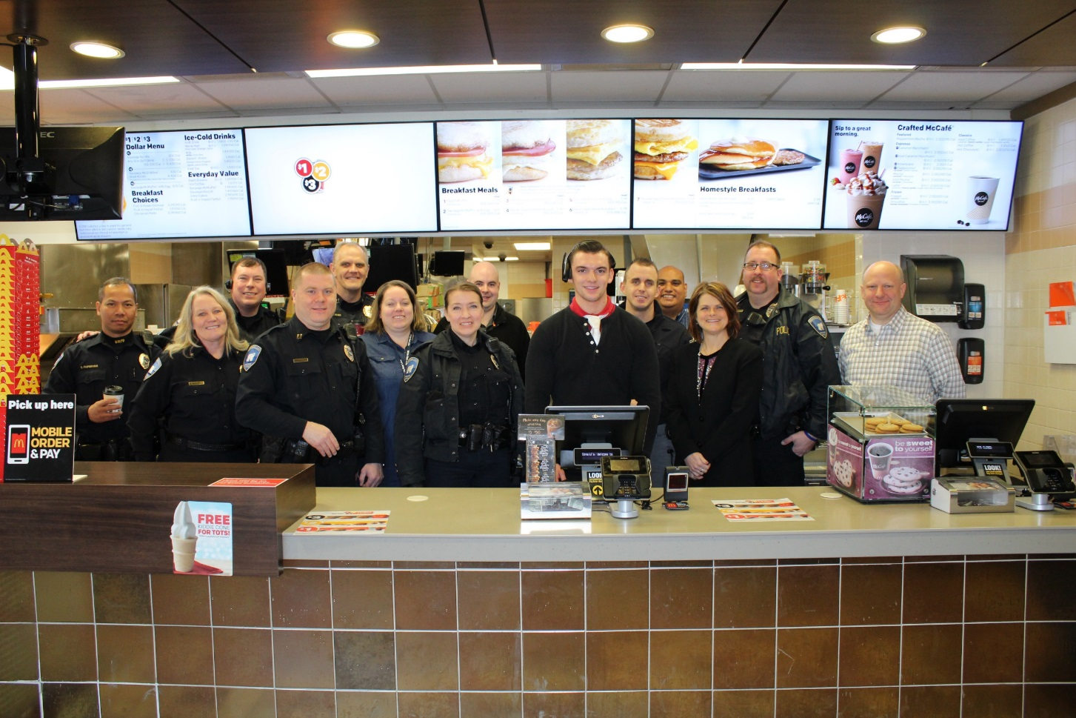
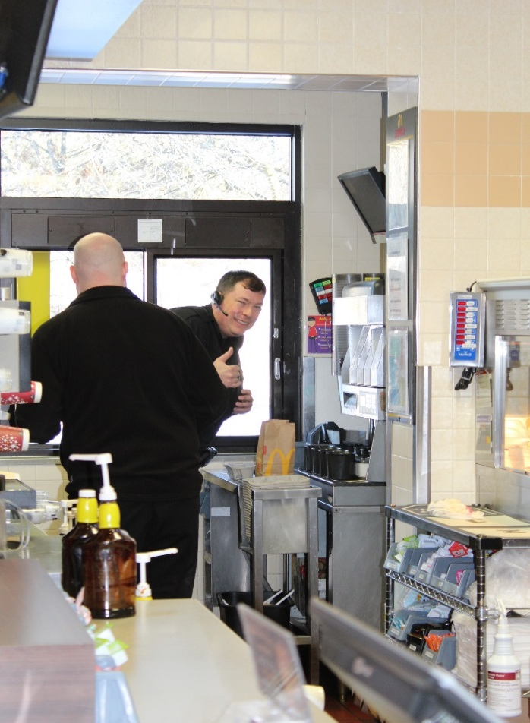
Coffee With A Cop
McDonalds – Highway 61, January 2018

Slide 3
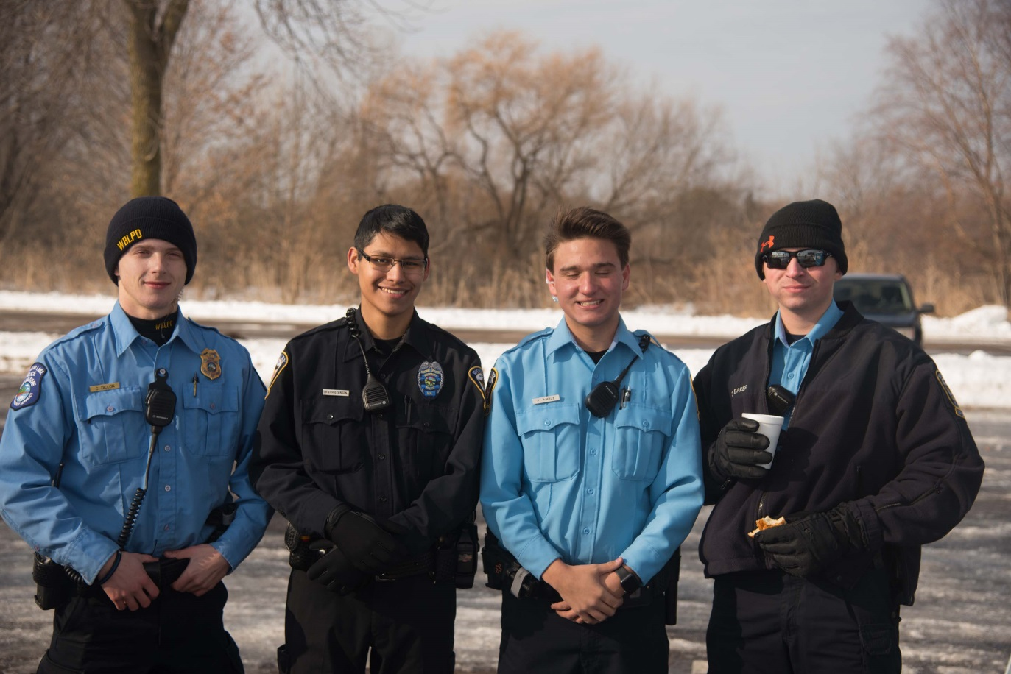
Special Olympics Polar Plunge January 27, 2018

Slide 4
Polar Plunge January 27, 2018

Slide 5
CERT Academy – Spring 2018

Slide 6
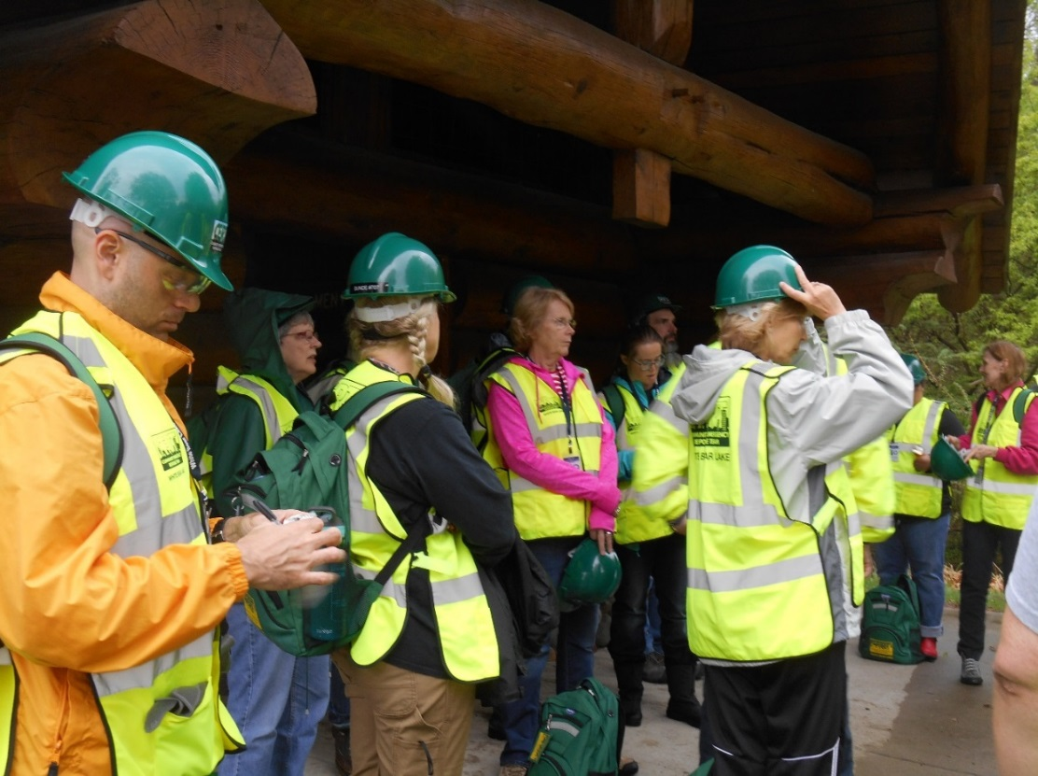

Slide 7
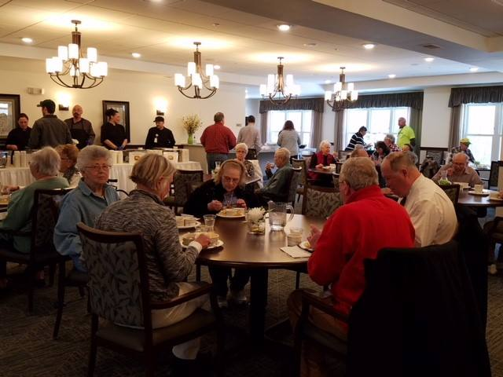
White Bear Heights – CERT Benefit March 23, 2018

Slide 8
Mock Crash – April 2018

Slide 9
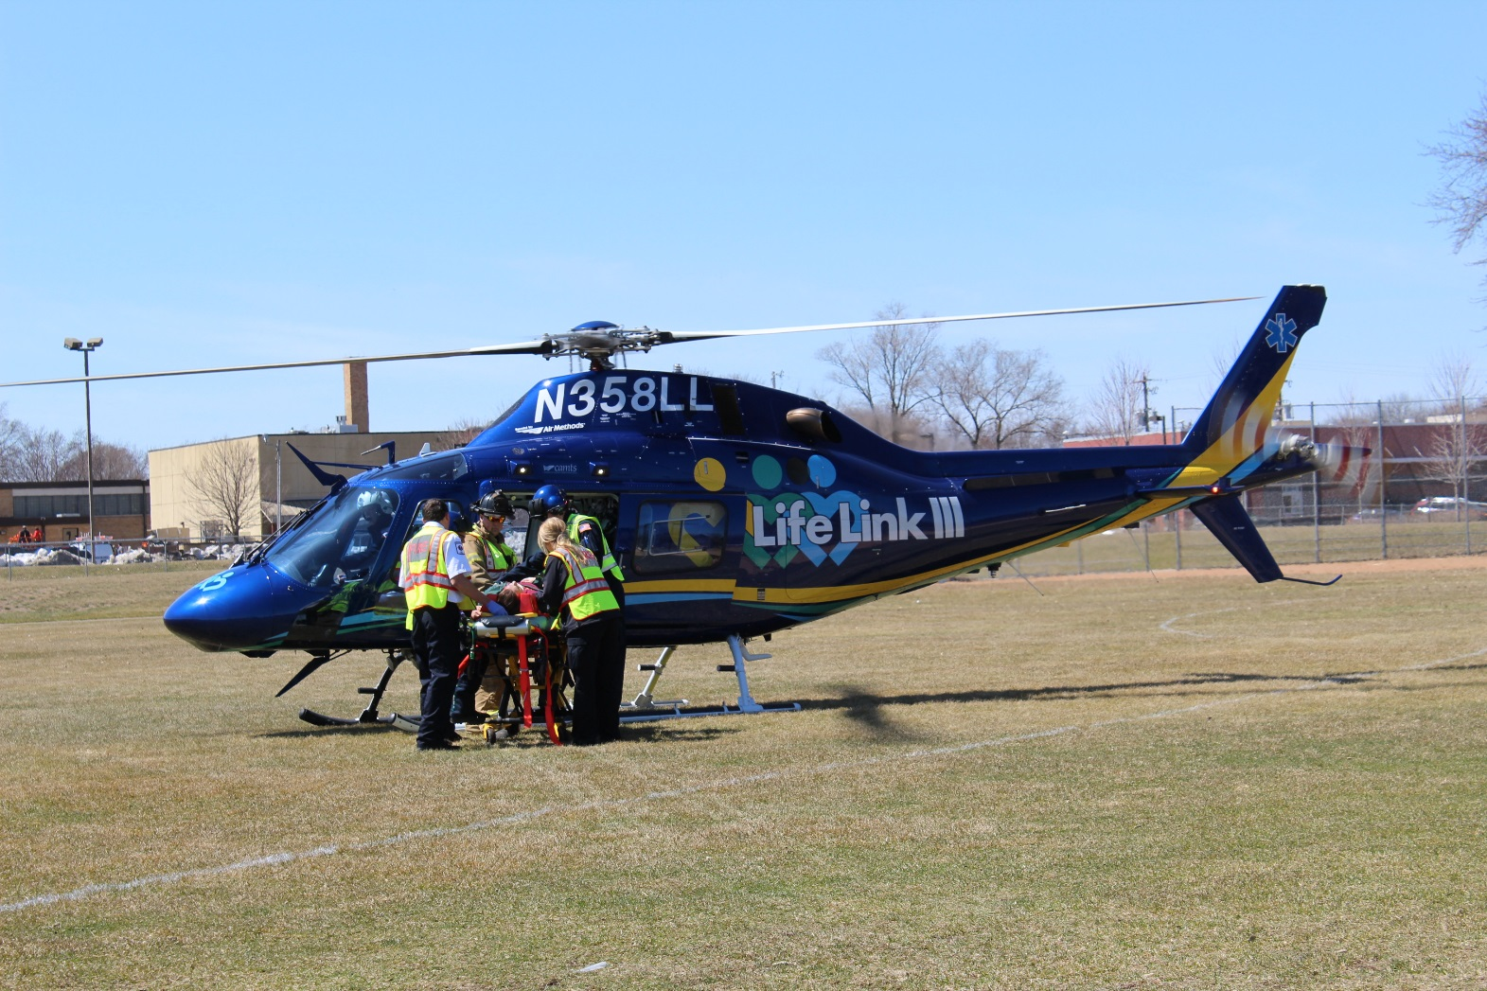

Slide 10
Fraud/Scam Presentation April 26, 2018

Slide 11
Dispatch Transition

Slide 12
Dispatch Transition

Slide 13
Mobile Field Force

Slide 14
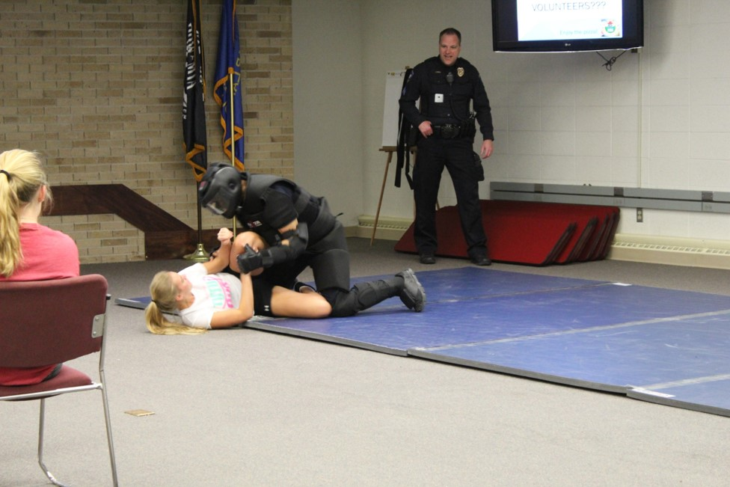
High School Girl’s Personal Safety
April 18th– 30 high school girls

Slide 15
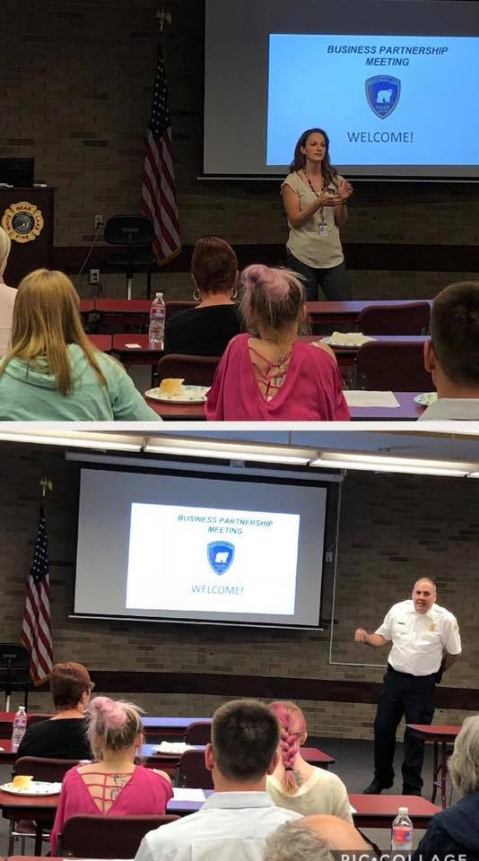
Business Meeting May 7, 2018

Slide 16
Law Enforcement Memorial- May 17th, 2018

Slide 18
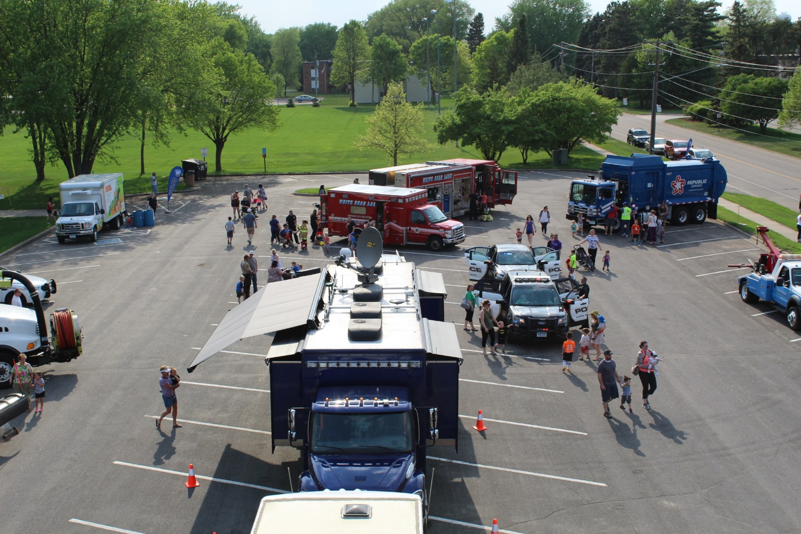
Touch A Truck – Podvin Park
May 17, 2018

Slide 21
Ramsey County SWAT

Slide 22
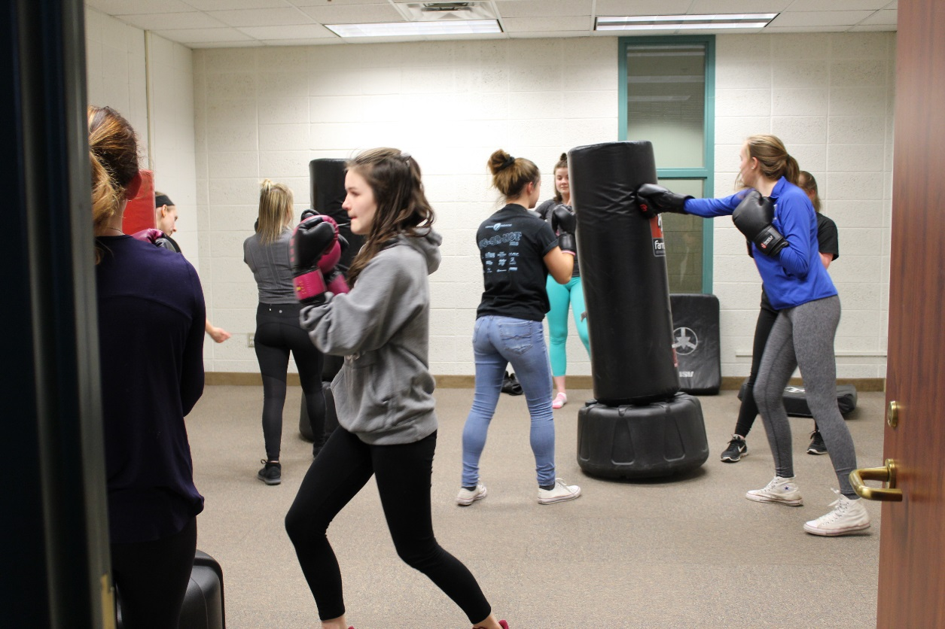
Middle School Girl’s Personal Safety May 21, 2018

Slide 23
Memorial Day Parade May 28, 2018

Slide 24
Bike Rodeo June 16, 2018

Slide 25
Thomasville Coffee With a Cop June 22, 2018

Slide 26
Special Olympics Torch Run June 22, 2018

Slide 27
Donuts With the Cops June 29, 2018

Slide 28
Donuts with the Cops June 29, 2018

Slide 29
Marketfest 2018

Slide 30
Fireworks July 4, 2018

Slide 31
DARE 2018 6 Schools

Slide 32
Animal Control
Posted on Facebook and within 12 hours, it had been shared 205 times and had “reached” nearly 15,000 people

Slide 34
Citizen’s Police Academy

Slide 35
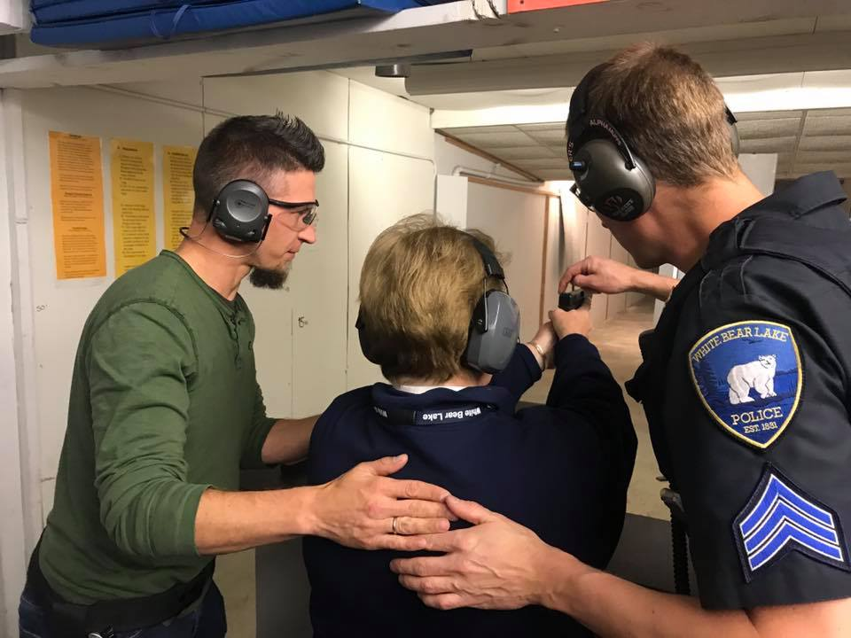
Citizen’s Police Academy

Slide 36
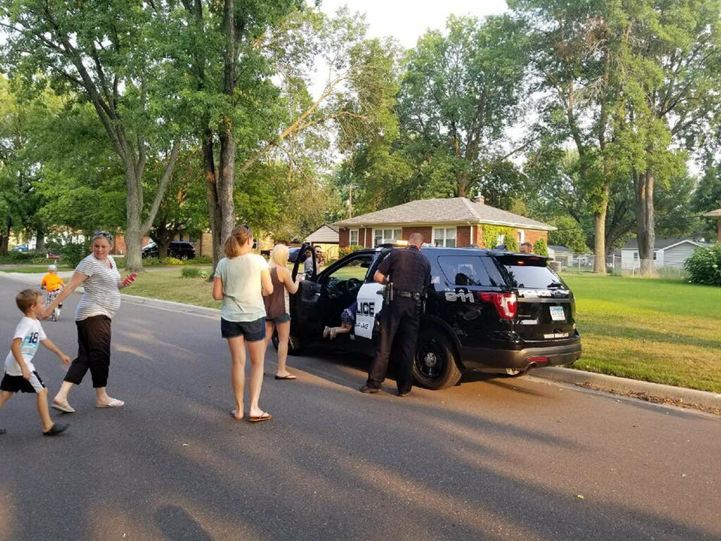
National Night Out

Slide 37
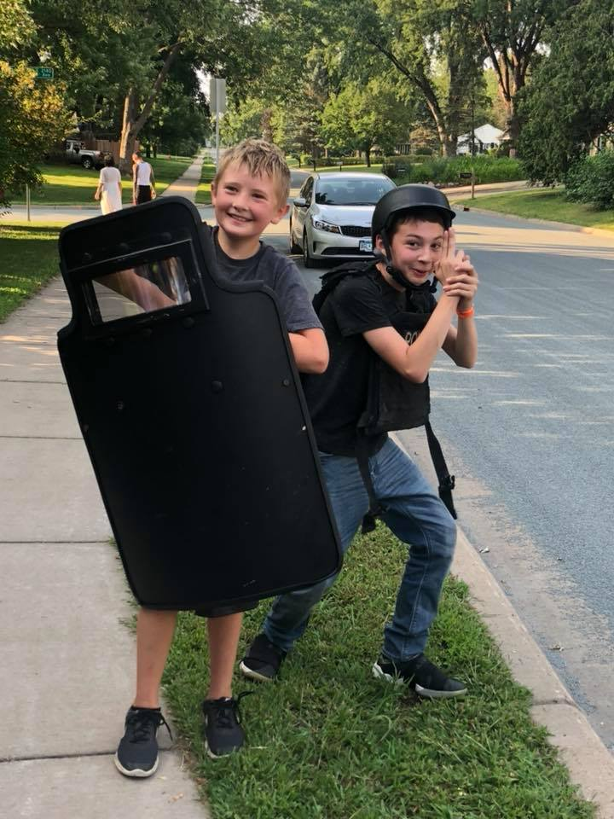
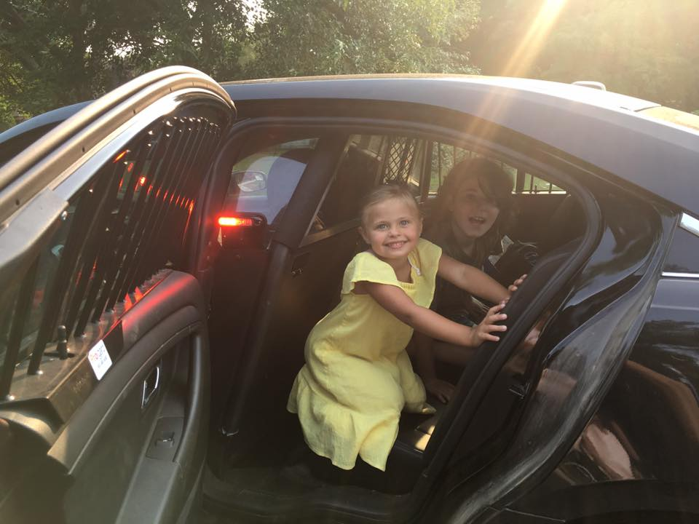
National Night Out

Slide 38
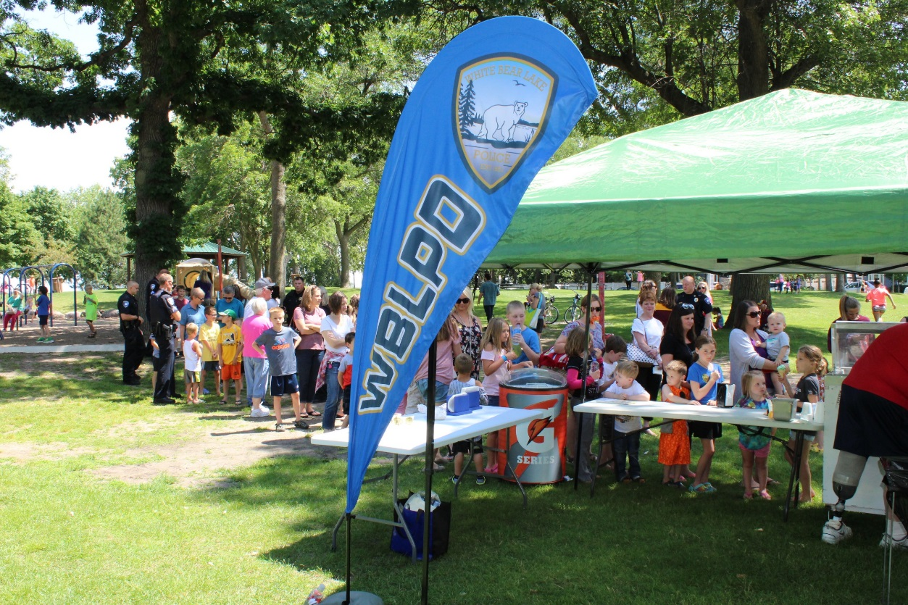
Cone With A Cop July 25, 2018

Slide 39
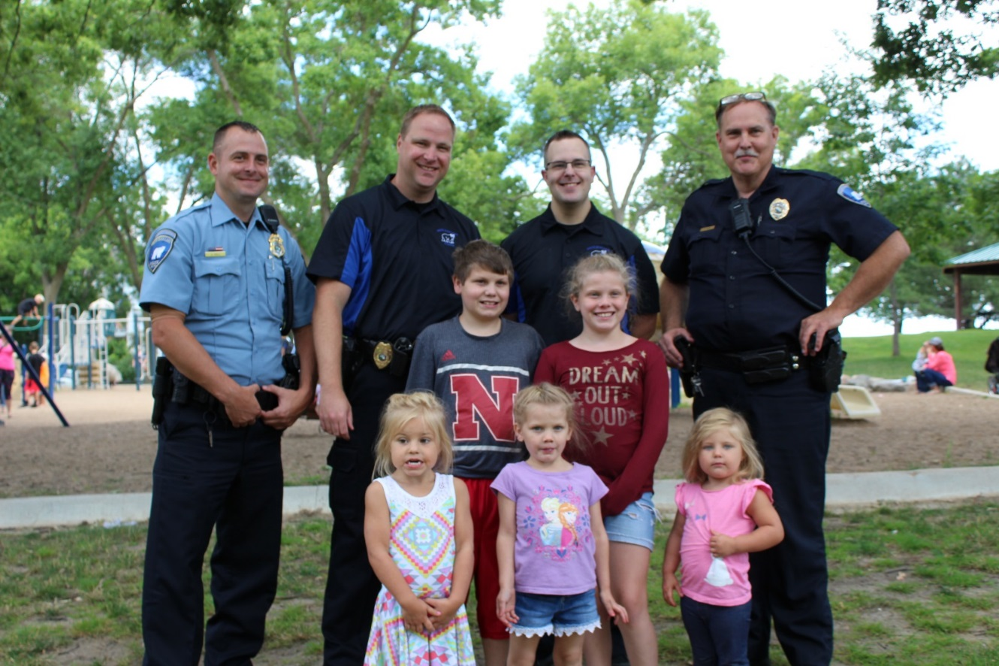
Cones with a Cop July 25, 2018

Slide 40
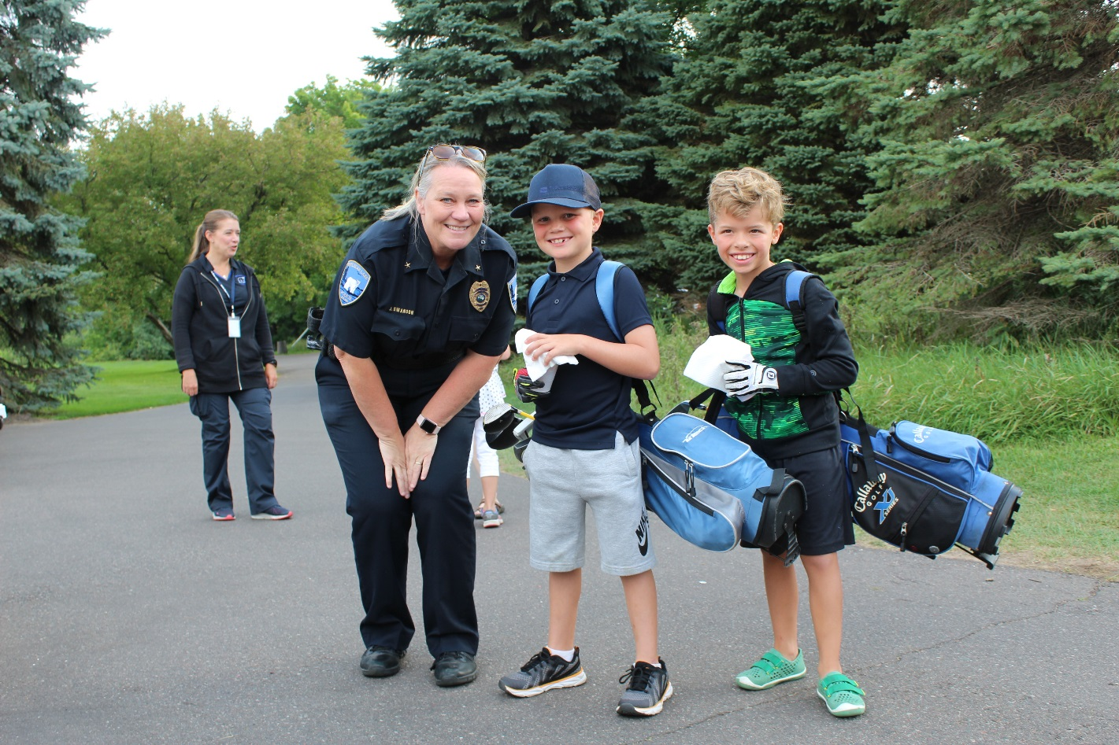
Gem Lake Golf Junior League Donuts with the Cops

Slide 41
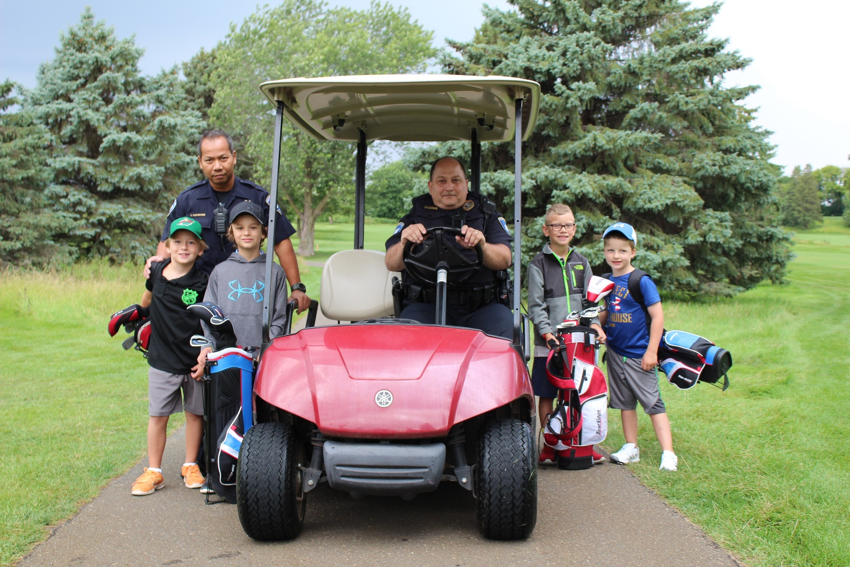
Gem Lake Golf Course

Slide 42
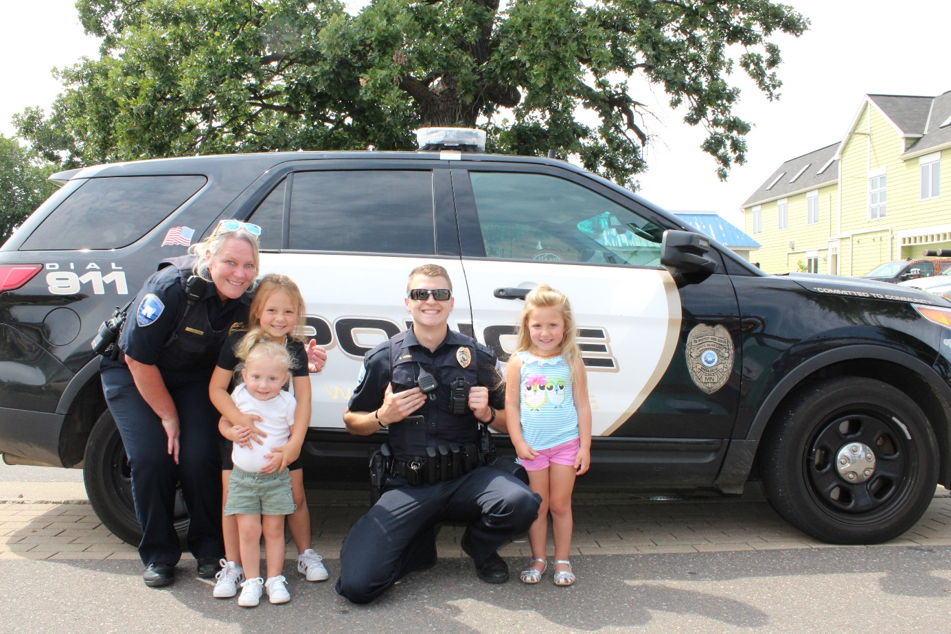
Floats with the Fuzz – Tallys Dockside August 2018

Slide 43
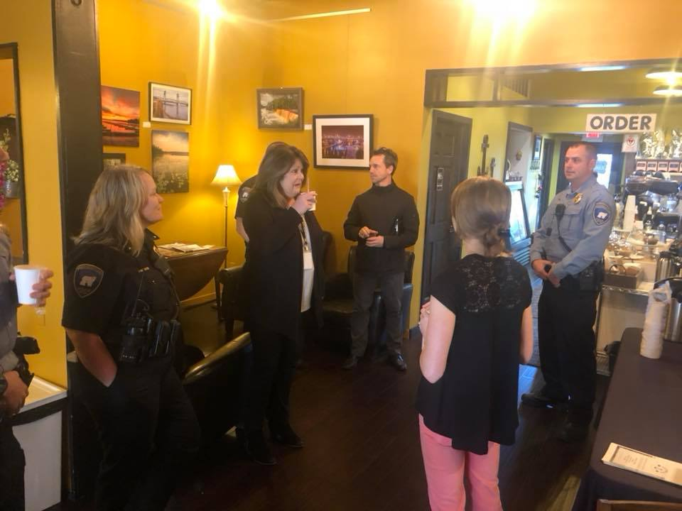
Coffee with a Cop Anchor Coffee
October 4, 2018

Slide 44
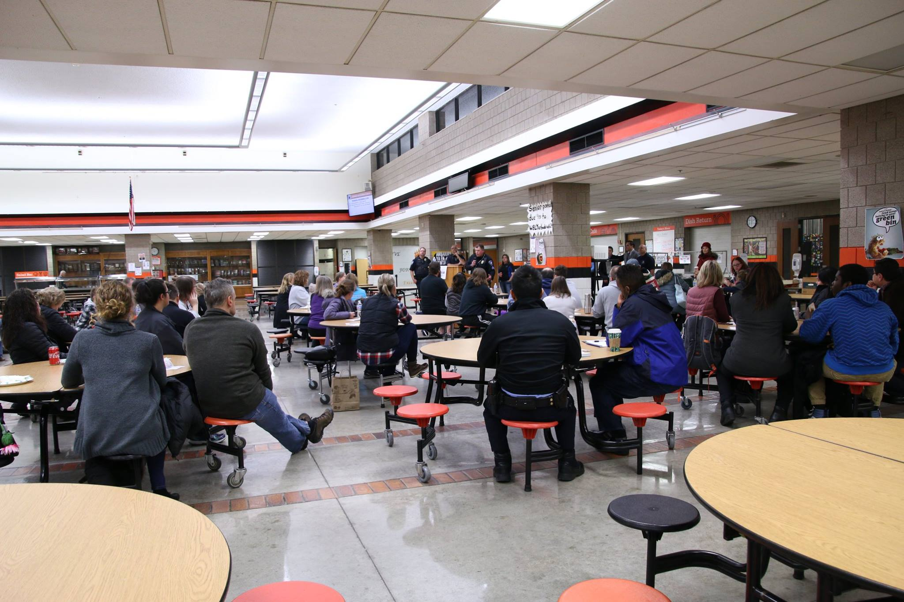
Parent Safety Night – South Campus
November 8, 2018

Slide 45
Bear Power Family Yoga Day
November 10, 2018

Slide 46
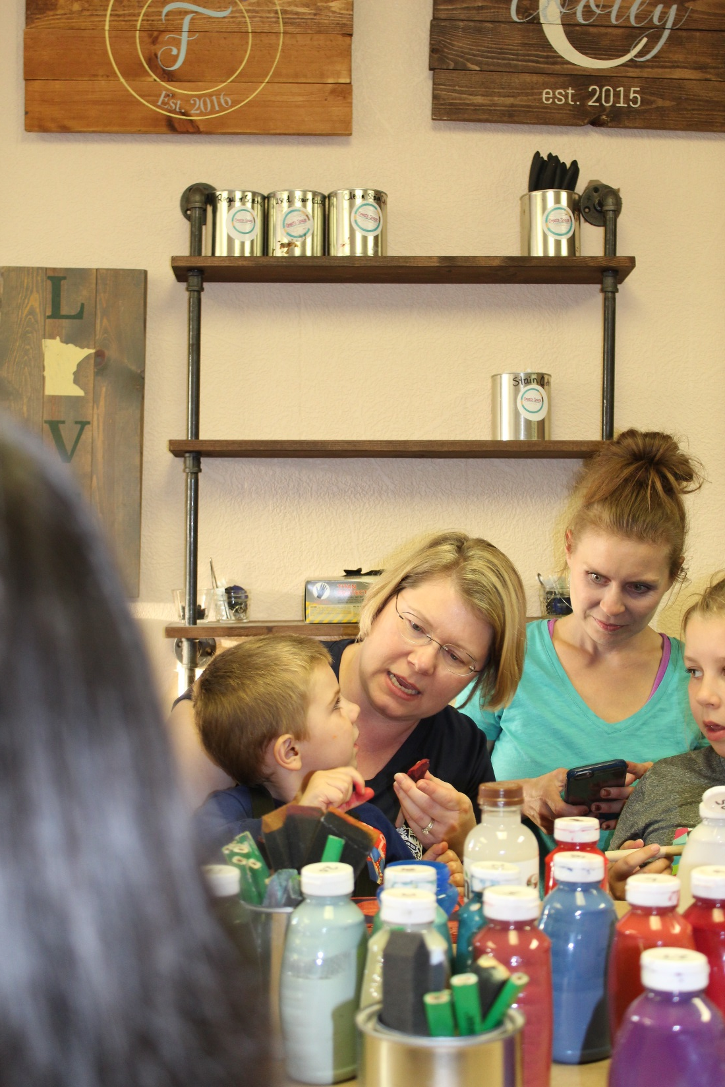
Paint with the Police – Create Space
November 14, 2018

Slide 47
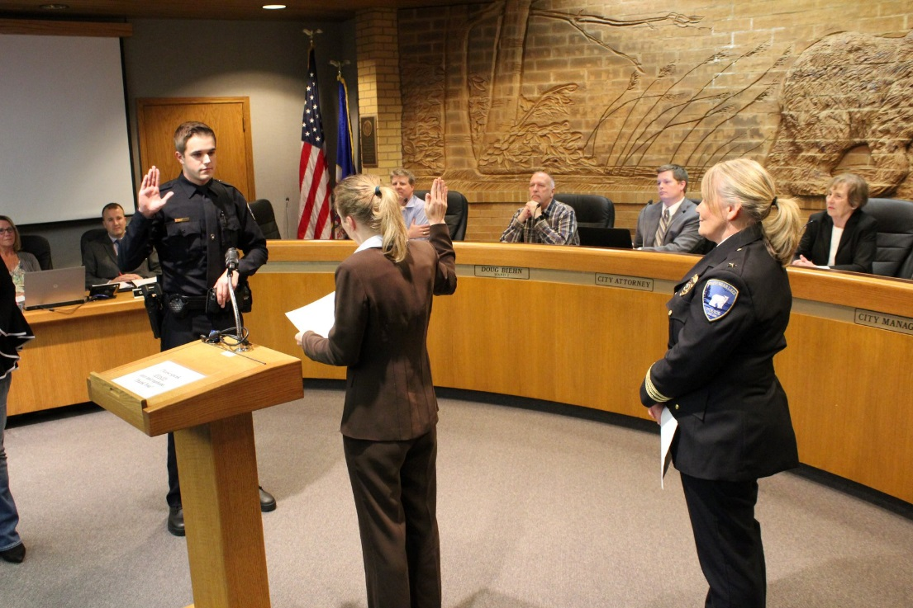
New Officers Marc Verrill and Sam Shafer

