Slide 1

Introduces the
South
WB L
oop
area

Slide 2
oop
South
WB L
area
Concept
Initiated through the White Bear Community Forum on Seniors’ Transportation Sub-committee
Newtrax in conjunction with the White Bear Senior Center conducted focus groups to hear priorities
Met with DARTS to hear about their community circulars and learn best practices
Made first run of pilot on Oct. 5, 2017

Slide 3
oop
South
WB L
area
Currently
Operating South Loop Pilot on Thursdays from 10:00am – 12:30pm
Operating three buses so each site will be reached every 20 minutes
Stopping at 9 residential facilities and 5 retail centers
Experiencing ridership growth!
Working out route timing and building confidence in the service

Slide 4
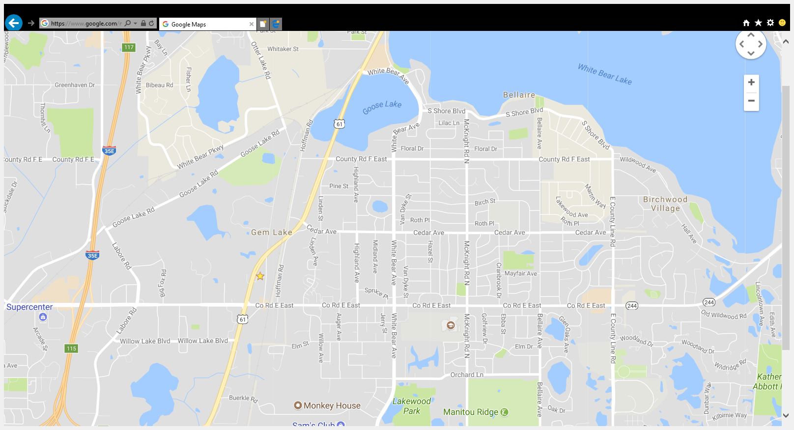

oop
The Bus Loop runs on Thursdays & begins at 10:00am and runs until the last drop-off around 1:00pm. Refer to stop times on back for your facility.
Get on and off at any of our scheduled stops and our bus will be back in 20 minutes for another pickup.
South
WB L
Kowalski’s
area
For more information contact us at: 651-846-9302 dispatch #: 651-789-6221
WB Senior Center
Senior Facility Stops
Retail/Restaurant Destinations
Briarcliff Manor
-Target
-Fresh Thyme
-Dollar Tree
-Chipotle
-Jersey Mike’s Subs
The Waters
Voluntary Donation Service…Pay what you wish
Piccadilly
-Festival Foods -Dollar Tree -Caribou Coffee
The Lodge
East Shore Place
-Jimmy’s
-Red Savoy’s
-Jimmy Johns
Gable Pines
The Boulder’s
-CVS
-Subway
-Donatelle’s -Ace Hardware
ALDI’s
-Walmart -Wendy’s -KFC
Willow Woods Apartments

Slide 5

South
On Thursdays this fixed route loop will service the south end of White Bear Lake area communities near the County Road E corridor. From restaurants to retail to grocery to our local WBL Senior Center, the bus circular will provide a safe and convenient way to get about town. Come aboard to take care of your errands or just take a ride to stop and get a cup of coffee. See our schedule below for stop times and locations…
oop
WB L
area
Senior Facility Stops
Retail/Restaurant Destinations
Voluntary Donation Service

Slide 6
oop
South
WB L
area
Future
North loop focused on Downtown & Hwy 96 corridor
White Bear Senior Center as a connection point
Incorporate elementary school volunteering into route
Provide access to those living independently in their homes on a pre-scheduled basis

Slide 7
oop
South
WB L
area
Financials
Cost of South Loop costs approximately $15,000 annually
The $15,000 cost is solely for operations (ie. Driver wages and fuel)
Newtrax makes in-kind contribution through use of vehicles at no cost
Adding a North Loop would cost approximately $5,000 per vehicle per year as currently constructed

Slide 8
oop
South
WB L
area
Financial Contributors
Kowalski’s - $2,000
Lake Area Bank - $1,000
Greater White Bear Lake Community Foundation - $1,000
Vadnais Heights Area Community Foundation - $1,000
Vadnais Heights Lions Club - $1,000
Transfer of Lionmobile to Newtrax

Slide 9
oop
South
WB L
area
Future Financial Support
Assistance from senior residential partners – subsidized facilities within routes will be included at no cost
Voluntary contributions from riders
Additional private funding
Public support

Slide 11

Truth in Taxation Hearing

Slide 14
Trends
Since 2007, tax levy has remained relatively constant.
Maintained essential services & kept pace with infrastructure investments
LGA has remained relatively flat; interest revenues have been significantly reduced.

Slide 15
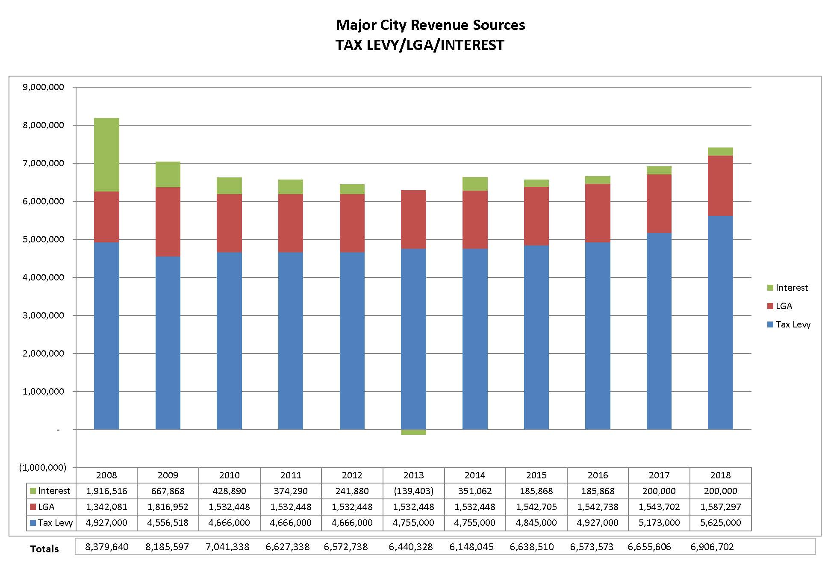
Major City Revenue Sources
TAX LEVY/LGA/INTEREST

Slide 16
Relatively Constant Levy
Planned drawdown of reserves by $1.3 million to offset operations
Shift of the tax levy from infrastructure to operations by $583,000 (11%)
Reallocation of portion of LGA by $525,000 from infrastructure to operations.

Slide 17
Reserves
Employee Expense Fund
Intended to operate on a “break even” basis; drawdown not sustainable into the future.
Proposed Levy reassigns $226,000 reliance on Employee Expense Fund to the Tax Levy.

Slide 18
Capital Fund Challenges
Transfer of LGA, shift in levy allocation and loss of interest revenues has placed pressure on capital funds.
Projected fund balance for Equipment Fund is $432,204 after 2018.
Proposed levy ($146,000) would begin to rebuild revenue stream for Equipment Fund.

Slide 19
Economic Trends & the Local Economy
The economy continues to expand while inflation remains below Federal Reserve bench mark goal of 2%.
Wage earners have seen compensation increase annually since 2014 (2.25%-3.00%).
Ramsey County’s unemployment has dropped to 2.4% - lowest since 1999. Labor market has become increasingly more competitive.
Construction Permits:
  2016: $42 million
  2017: estimated $32 million
  2018: estimated $40 million

Slide 20
2018 Proposed Tax Levy
Anticipates three central elements that will require additional resources:
Eliminate reliance on Reserves for operations ($226,000) 50% of levy increase
Commit resources to fund capital replacement of ($146,000) 32% of levy increase
Fund general operations ($80,000), 18% of levy increase.
  General Fund operational tax levy increase represents a 1.6% increase over 2017.

Slide 21
2018 Proposed Tax Levy
An increase of $452,000 over 2017 tax levy
General Fund | 2017 | Additional Levy | 2018
Operations | 4,891,000 | 80,000 | 4,971,000
Reserve Utilization Adjustment |  | 226,000 | 226,000
Total General Fund | 4,891,000 | 306,000 | 5,197,000
Equipment Fund | 50,000 | 146,000 | 196,000
Building Fund | 100,000 | - | 100,000
Debt Service | 132,000 | - | 132,000
Total Tax Levy | 5,173,000 | 452,000 | 5,625,000

Slide 22
Market Value
The County assessor assigns market value to each parcel of property, which is further defined by its property class (residential, apartments, commercial).
2018 Total Market Value: $2,569,236,700
8.70% increase over 2017

Slide 23
Tax Capacity
This is the percentage of each parcel’s market value, dependent on the class rate assigned by the state.
  Example: A home valued at $194,500 classified as a residential homestead has a class rate of 1.0 percent; tax capacity equals $194,500 less Market Value Exclusion of $19,700;
          $174,800 x .01, or $1,748.

Slide 24
Tax Rate
Calculated by dividing the City’s net tax capacity by the City’s tax levy (less fiscal disparities), as set by the City Council.
$25,988,438 / $4,918,379 = 18.925%
2017 tax rate = 18.969%

Slide 25
Property Tax Calculation
Determined by multiplying the property’s tax capacity by the tax rate.
  A home valued at $194,500 classified as a residential homestead has a class rate of 1.0 percent
  Tax capacity equals $194,500 less Market Value Exclusion of $19,700
  $174,800 x .01, or $1,748
  $1,748 x 18.925% = $330.80

Slide 26
Real Estate Market
City’s overall property valuation increased 8.70% in 2017, as compared to 18.1% total increase over previous four year period, (2013-2016)
Residential valuation overall increased 6.3%
Apartment valuation overall increased 14.4%
Commercial valuation overall increased 11.7%

Slide 27
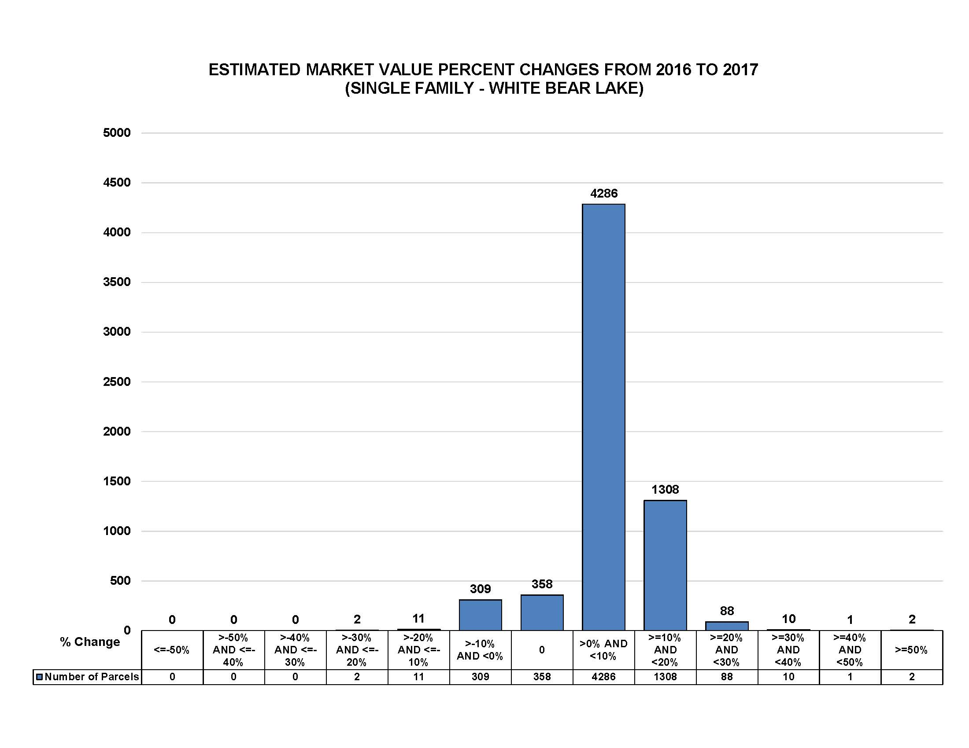

Slide 28
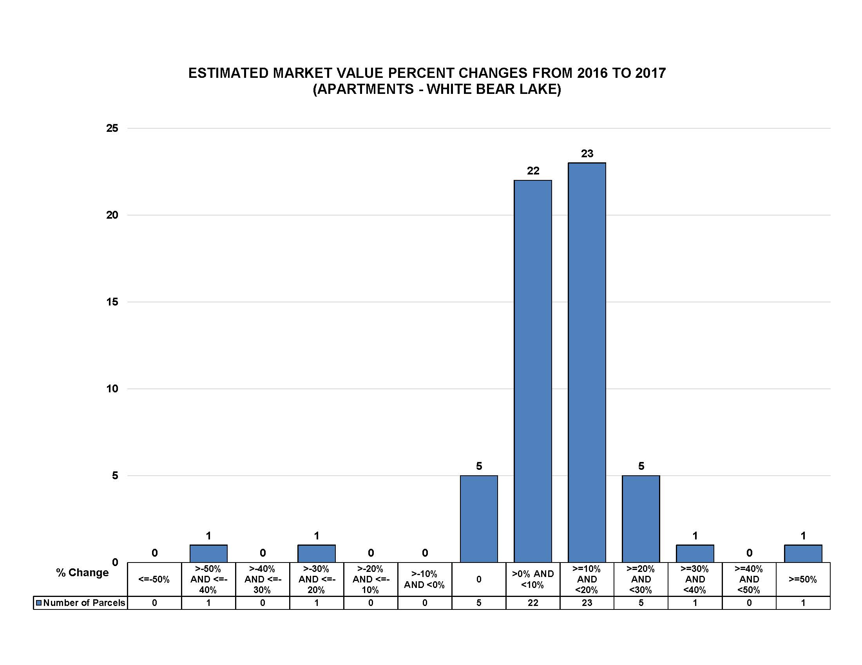

Slide 29
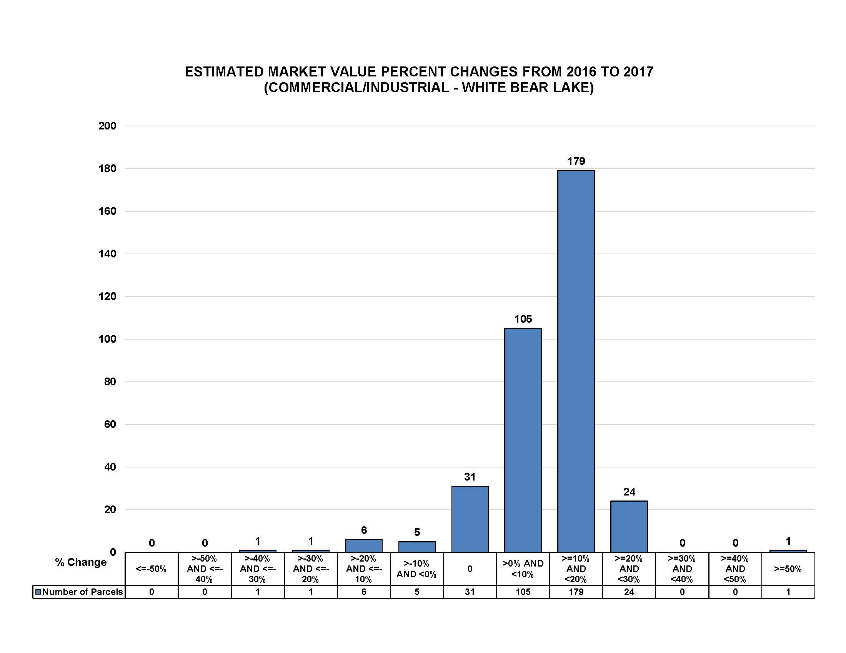

Slide 30
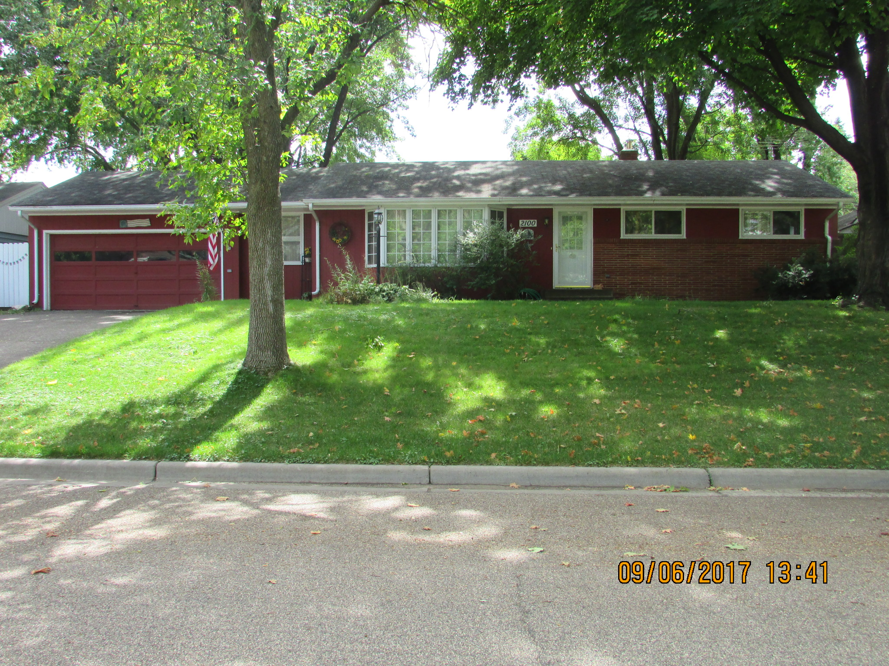

Slide 31
YEAR Median Value Taxable Value City’s Tax Impact
2018 | 208,400 | 189,916 | 359.39
2017 | 194,700 | 174,983 | 331.95
2016 | 184,700 | 164,083 | 323.08
2015 | 181,300 | 160,377 | 326.64
2014 | 167,100 | 144,899 | 305.77
2013 | 163,600 | 141,084 | 303.27
2012 | 179,200 | 158,088 | 315.23
2011 | 186,450 | 186,450 | 330.11
2010 | 196,200 | 196,200 | 324.12
2009 | 213,500 | 213,500 | 326.70
2008 | 224,800 | 224,800 | 371.46
2007 | 224,000 | 224,000 | 396.61

Slide 34
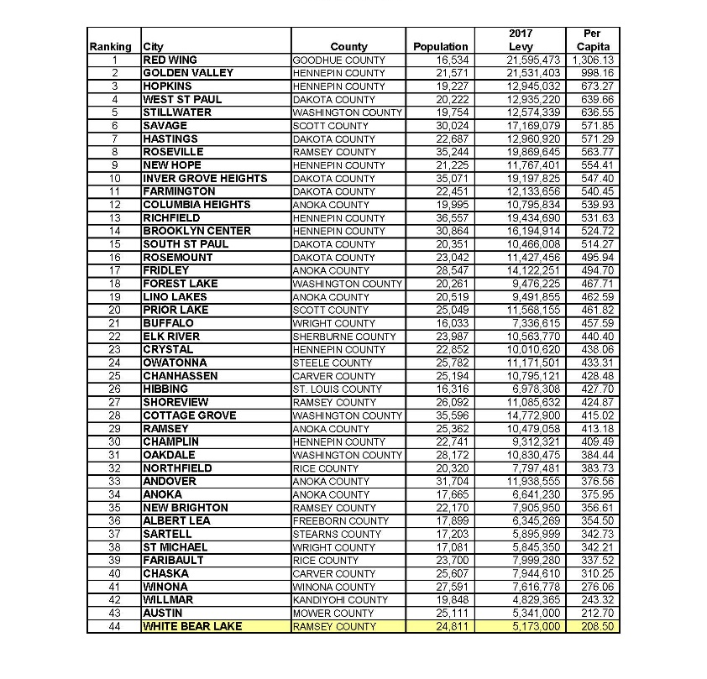
City of White Bear Lake
Tax Levy Comparison – State Wide
City Population between
16,000 – 37,000 Capita
For Fiscal Year 2017

Slide 35
Public Hearing

Slide 46
Manufacturing Property
City of White Bear Lake
Commercial
Property Tax Impact
Comparison from 2007 & 2018
Manufacturing
 |  | Estimated | Net | Percent
9th Street | 2007 | 2018 | Change | Change
Market Value | 3,850,000 | 4,229,900 | 379,900 | 9.87%
Tax Capacity | 76,250 | 83,848 | 7,598 | 9.96%
Tax burden
City | 8,589.53 | 10,196.82 | 1,607.29 | 18.71%

