Slide 1
CITY OF WHITE BEAR LAKE
2021 PAVEMENT REHABILITATION PROJECTs
CITY PROJECT NO.
21-01, 21-06 & 21-13
PROJECT Presentation
NOVEMBER 25, 2020
Notes:
Project Introduction

Slide 2
ENGINEERING DEPARTMENT
Paul Kauppi | City Engineer/Public Works Director
Nate Christensen | Civil Engineer
Dan Holzemer | Senior Engineering Technician
Jayson Stejskal | Engineering Technician III
Carisa Vermeersch | Engineering Secretary
Connie Taillon | Environmental Specialist
Notes:
Staff introduction, we are here to assist you with questions and concerns regarding this project. Paul and Nate will be in the office most of the time. Dan will be overseeing the project, and running the survey crew. Jayson will be the inspector for the project along with a seasonal worker. Connie will be coordinating the Raingarden Program with the watershed districts. Carisa will be the point of contact for all the project questions. She will be the one that answers most phone calls and e-mails.

Slide 3
RECONSTRUCTION PROGRAM OVERVIEW
2-3 MILES PER YEAR
93% WITH CURB & GUTTER
Notes:
Typically the City “reconstructs” 2-3 miles a year. The goal is to get all City owned streets to current engineering standards (a minimum of 6” of class 5 gravel, and a minimum of 3 1/2” of asphalt). This usually includes utility modifications and adding storm sewer features where needed. Around 93% of City owed streets are up to current standards. The City will not have a reconstruction program this year.

Slide 4
REHABILITATION PROGRAM OVERVIEW
MILES VARIES EACH YEAR
16% COMPLETED CITYWIDE (SINCE 2011)
Notes:
Typically, every year the City also has a Mill & Overlay/ Pavement Rehabilitation program. While the City is trying to reconstruct all City owned streets to current standards, it is also important for the City to maintain the assets it has. These are the projects that we are proposing to the City Council this year as well as a look into what is anticipated for the next five years.

Slide 5
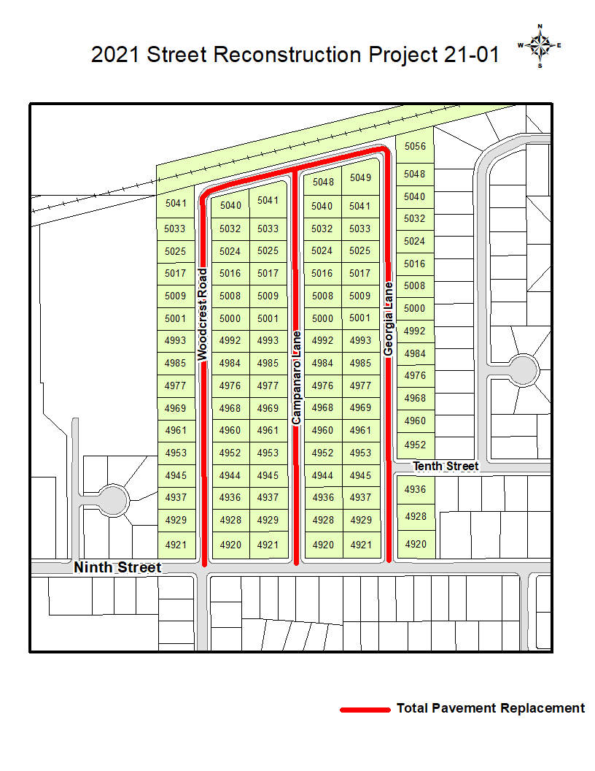
Notes:
Here is the location for City Project 21-01. These roads are built with a curb and gutter section, 6” of gravel, but only about 2” of bituminous (blacktop). The City is proposing “Full Pavement Replacement” for this area. We propose removing all the bituminous, regrading the existing gravel, and paving back 3 ½” of bituminous.

Slide 6
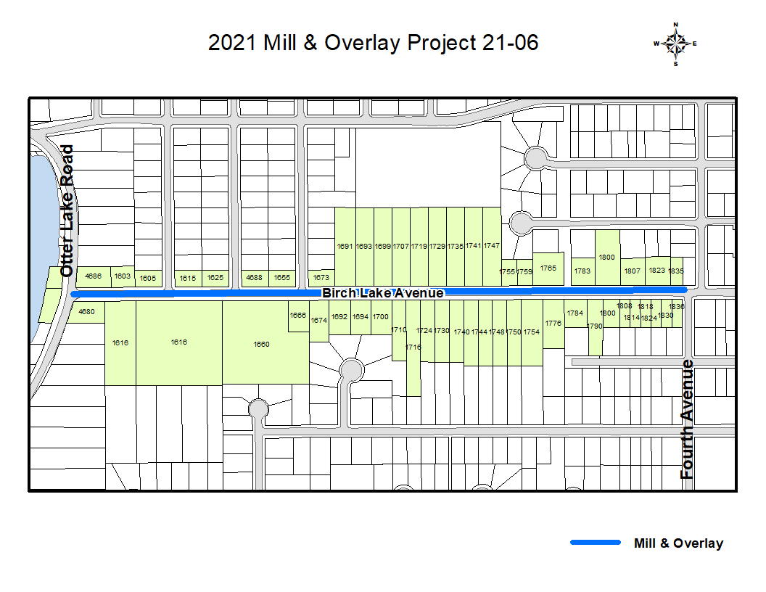
Notes:
Here is the location for City Projects 21-06. Birch Lake Avenue was constructed in 2001. The pavements in the late 1990’s early 2000’s have a problem with delaminating. Through the years the City’s Public Works has patched and “spot milled” this road. We are proposing a Mill and Overlay for this area.

Slide 7
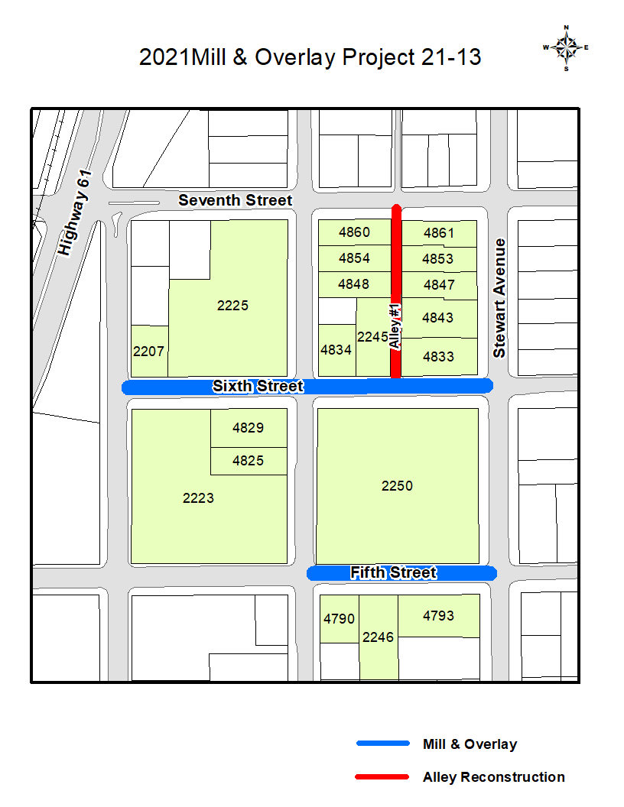
Notes:
City Project 21-13 is located in 3 other areas throughout the City. This first area shown here is a Mill and Overlay for Fifth Street and Sixth Street (shown in blue). The Alley (shown in red) will be reconstructed to current standards.

Slide 8
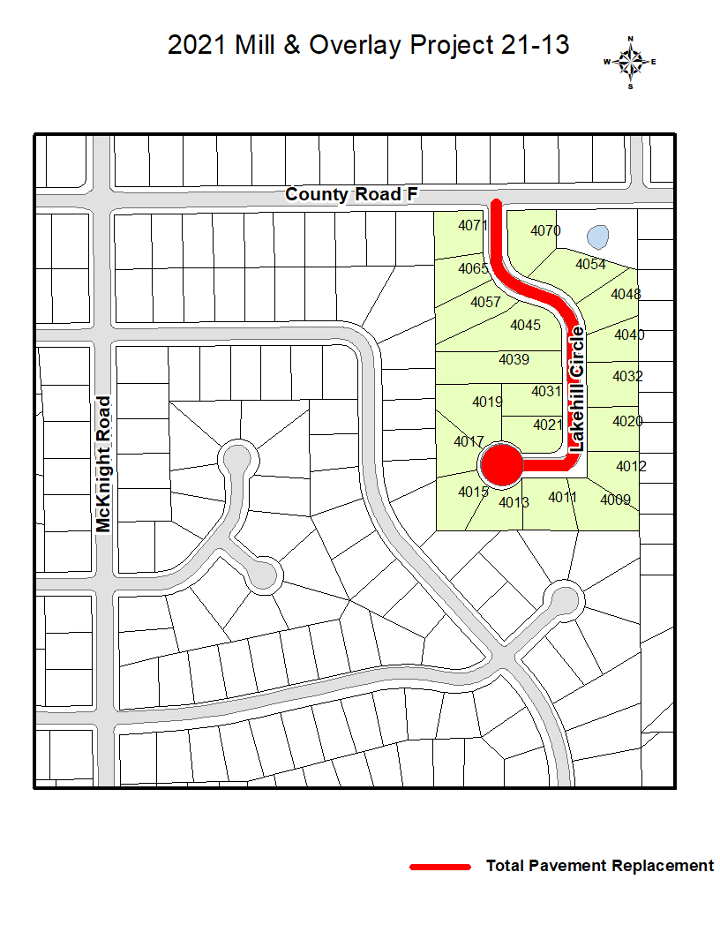
Notes:
The second area is Lakehill Circle. This is a developer built road in 2 phases, in 1976 and 1980. It was built with 2” of bituminous (blacktop) and 10” of gravel. The City is proposing “Full Pavement Replacement” for this street. We propose removing all the bituminous, regrading the existing gravel, and paving back 3 ½” of bituminous.

Slide 9
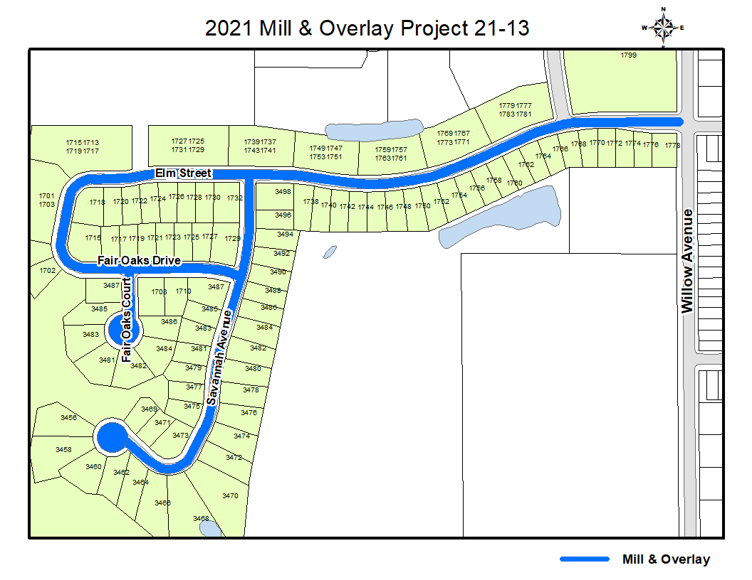
Notes:
The third area the City is proposing for City Project 21-13 is the “Willow Marsh” neighborhood. We are proposing a Mill and Overlay for this area.

Slide 10
Notes:
This is a visual of what a “proper section” looks like for roadway. The City’s current standard section is 3 ½ inches of bituminous pavement (shown as the wearing surface) and 6 inches of Class 5 gravel (shown as the base).

Slide 11
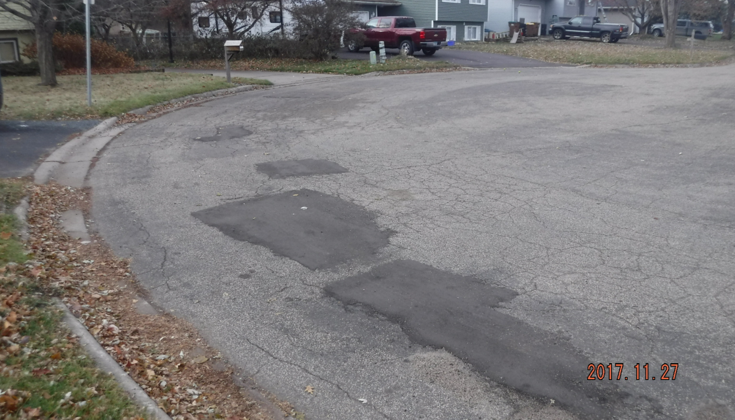
Causes of Pavement Deterioration
Traffic Volume
Vehicle Weight
POOR DRAINAGE
Temporary conditions
ENVIRONMENTAL DAMAGE
Notes:
The above listed are causes of pavement deterioration. The largest cause of pavement deterioration is water getting into the cracks of the pavement. When water freezes and thaws, it expands and contracts in these cracks, breaking up the pavement.

Slide 12
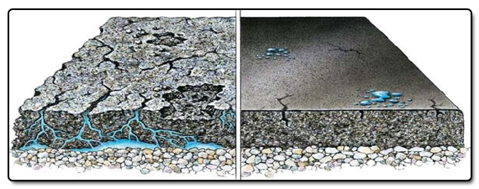
Before
After
Notes:
This picture is a great illustration of aging pavement (before) and new pavement (after). New pavement help waterproof streets from potential water damage.

Slide 13
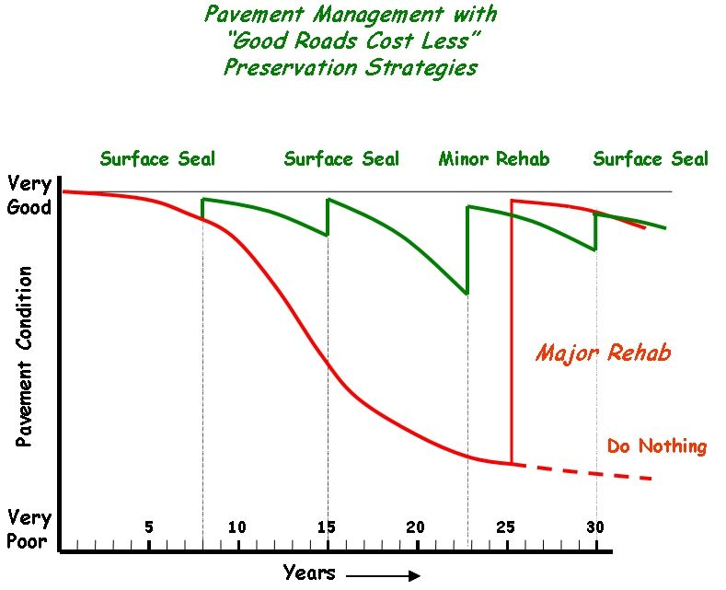
Notes:
The City has annual Crack Fill and Sealcoat jobs, which also help seal the pavement. The goal is to hit every City street about every 7 years. Mill and overlays (minor rehab) are usually needed when the street is about 20 and 30 years old. Full reconstruction is around 50 years. These are moving targets and roads are re-evaluated yearly. If streets were not maintained regularly, the pavement condition follows the red line, requiring a major rehab to soon. If we keep up on scheduled maintenance, the condition of the pavement should follow closer to the green line.

Slide 14
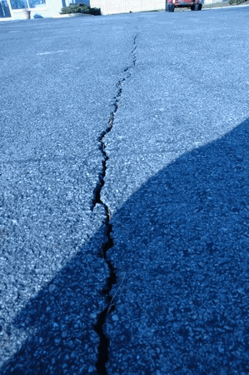
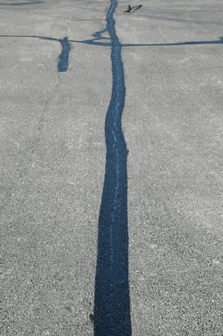
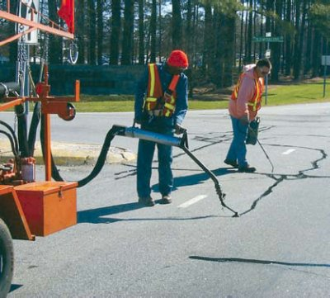
Pavement Preservation: CRACK SEALING
Notes:
The City has an annual crack filling program where we identify roads that are most in need of crack filling. The City hires a contractor for this work.

Slide 15
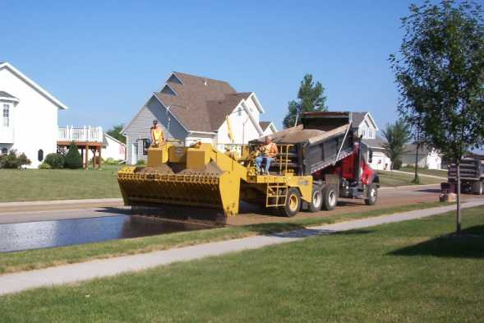
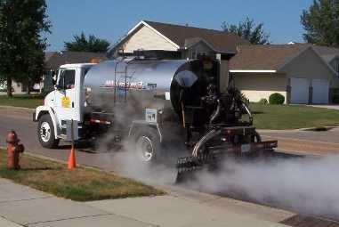
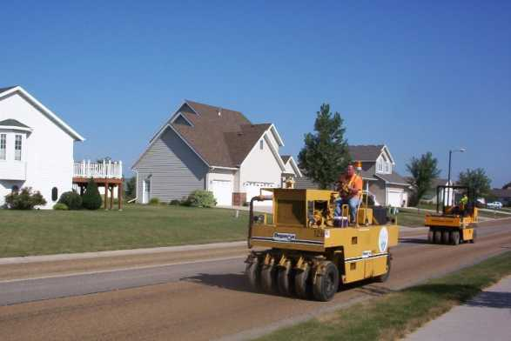
Pavement Preservation: Aggregate Seal Coating
Notes:
The City also has an annual Seal Coating Program. The City’s goal is to Seal Coat our roads about every 7 years, about 3 times prior to a mill and overlay. The City hires a contractor for this work. Above is a picture of a sealcoat process, we first sweep the streets, put down oil, put down rock, roll the rock, and sweep up loose rock after a couple weeks allowing the rock to bond to the oil.

Slide 16
Driveway Replacement Program (Alley only)
Once we hire a contractor, usually in early Spring, the City will send additional information
including prices.
Notes:
The City has a voluntary program available for the residents living on roads or alleys that are to be reconstructed. The only driveways that are eligible for replacement this year are driveways accessible from the alley. Once we have a contractor, the City will mail you information and prices on our Driveway Replacement Program.

Slide 17
PROJECT FUNDING
CITY CONSTRUCTION FUNDS
MUNICIPAL STATE AID
ASSESSMENTS TO BENEFITED PROPERTIES
Notes:
The City Street Reconstruction and Mill and Overlay programs are funded through a variety of funding sources. These include, but are not limited to the City Construction Funds, Construction Bonds, the City of White Bear Lake License Bureau located in City Hall. (If you need TABS, or have any DMV business come to the White Bear Lake License Bureau). Any City in Minnesota that has 5,000 or more in population is eligible for Municipal State Aid, that is funded through the gas tax. The City has taken advantage of this since the programs inception. And lastly, Special Assessments.

Slide 18
ASSESSMENT POLICY
UNIFORM, FAIR AND BENEFIT THE PROPERTY
APPRAISAL REPORT
FOLLOW STATE STATUTE 429
Notes:
The use of special assessments must be Uniform, Fair and Balanced. In order to accomplish this, the City adopted it’s Street Reconstruction Assessment policy in 1983. The City Mill & Overlay program and revising the assessment policy for Mill & Overlays was adopted in 2011. The procedures used by the City are those specified for Minnesota Statutes, Chapter 429, which provide that all, or part of the cost of improvement may be assessed against benefiting properties in accordance up to the benefits received. In order to prove this, the City hires an independent appraiser, we use Dahlen, Dwyer, Foley, and Tinker. To date the appraiser has reported that the “assessments … appear to be reasonable, acceptable, and can be substantiated in the marketplace.” Many cities chose different methods to assess for Mill & Overlay projects. Some assess $0, others assess 100% the cost of the work. The City of White Bear Lake assesses about 1/3rd the Improvement Cost. In 2021 the proposed assessments are to be about $1,200 per 80’ lot, $2,400 per 80’ lot for full pavement replacement, and $2,400 each for alley reconstruction. Note: The highest residential assessment on the roll includes a mill & overlay assessment and alley assessment is proposed to be $3,400. Commercial and Apartment assessments are currently being reviewed. The Assessment Hearing is scheduled for 9/21/2021.

Slide 19
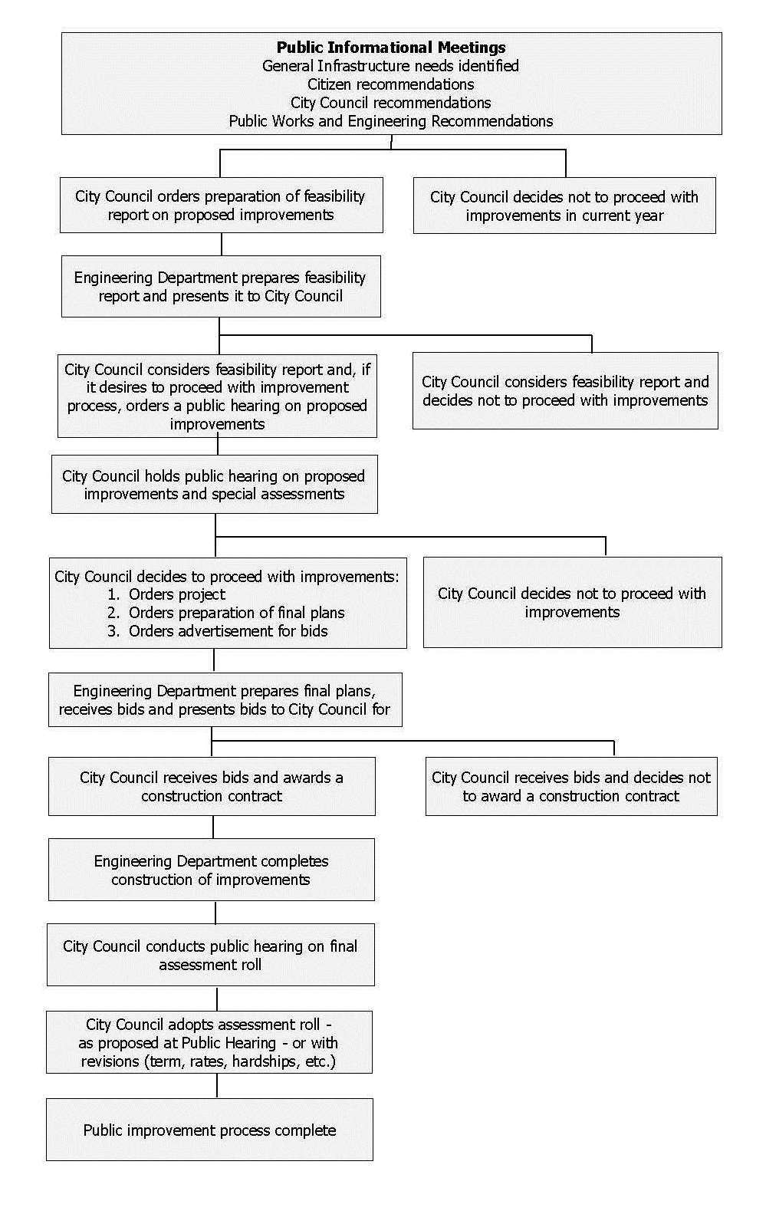
Public Improvement Process
ANTICIPATED SCHEDULE
FEASIBILITY REPORT TO CITY COUNCIL ON FEB 11, 2020
PUBLIC HEARING NOTICE TO PROPERTY OWNERS ON FEBRUARY 28, 2020
PUBLIC HEARING ON MARCH 10, 2020
CONSTRUCTION APPROXIMATELY MAY-OCTOBER 2021
Notes:
Above is the anticipated schedule for the 2021 Street Rehabilitation Projects.

Slide 20
ASSESSMENT PROCESS
City Council Orders Assessment Hearing on 8/24/21 the hearing is scheduled for 9/21/21)
City will mail final assessment notice by 9/8/21
City Council holds Assessment Hearing and levies the Assessment
At this point the property owner has 30 days to pay a portion or all of the assessment to the City, without penalty.
After the 30 days the City will turn over the remaining balance to Ramsey County to place on your property taxes for 10 years with interest. (the rate last year was 3.46% per annum of the unpaid balance)
Notes:
This is the summary of the State Statute 429 assessment process with anticipated dates.

Slide 21
SAMPLE ASSESSMENT BREAKDOWN
PAYMENT SCHEDULE
IF YOU WANT THE ASSESSMENT ON YOUR COUNTY TAXES SIMPLY DO NOTHING
RAMSEY COUNTY WILL ADD A $2.50 FEE PER YEAR FOR 10 YEARS
THE PAYMENT SCHEDULE WILL BE 1/10 OF THE PRINCIPAL PLUS INTEREST ON THE REMAINING BALANCE
Notes:
Above are sample assessments with breakdowns for certain amounts ranging from $1,500 - $4,000 with an assumed 5% interest rate.

Slide 22
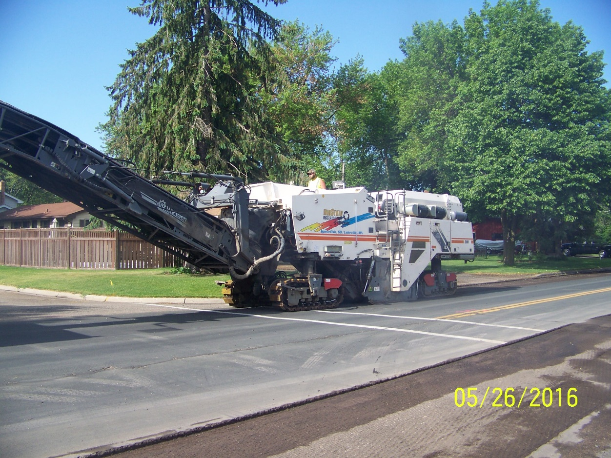
Construction Process
This is a brief overview of what to expect when we “come to your neighborhood””.
Notes:
The next slides show a brief presentation of what to expect for construction activities.

Slide 23
Private Utility Work
Xcel Energy will install new gas mains in the 21-01 construction area. They will contact you directly regarding this work.
If you have any specific questions or concerns, please contact Xcel Energy.
Notes:
Often during road construction, private utility companies like Xcel, Centurylink, and Comcast take a look at their own utilities and decide whether to upgrade them. As of today, Xcel Gas will be replacing their gas mains and services on Campanaro Lane, Georgia Lane, and Woodcrest Road. Xcel Gas will contact affected residents with more information closer to construction. Expect small holes to be dug by Xcel to locate existing utilities. Most of this work will take place in the yard, behind the curb. To date, no other areas are planned for private utility work.

Slide 24
Private Utility Work
Xcel Energy will install new gas mains in the 21-01 construction area. They will contact you directly regarding this work.
If you have any specific questions or concerns, please contact Xcel Energy.
Notes:
After the laborers dig all the “gopher holes” you can expect Xcel Gas to hire a contractor to Directional Bore a new gas main. Once the main is in place and “powered up” they will switch your service over to the new main. Xcel Gas will contact you, you will be with out gas for about 1 hour and they will have to re-light pilot lights, if necessary.

Slide 25
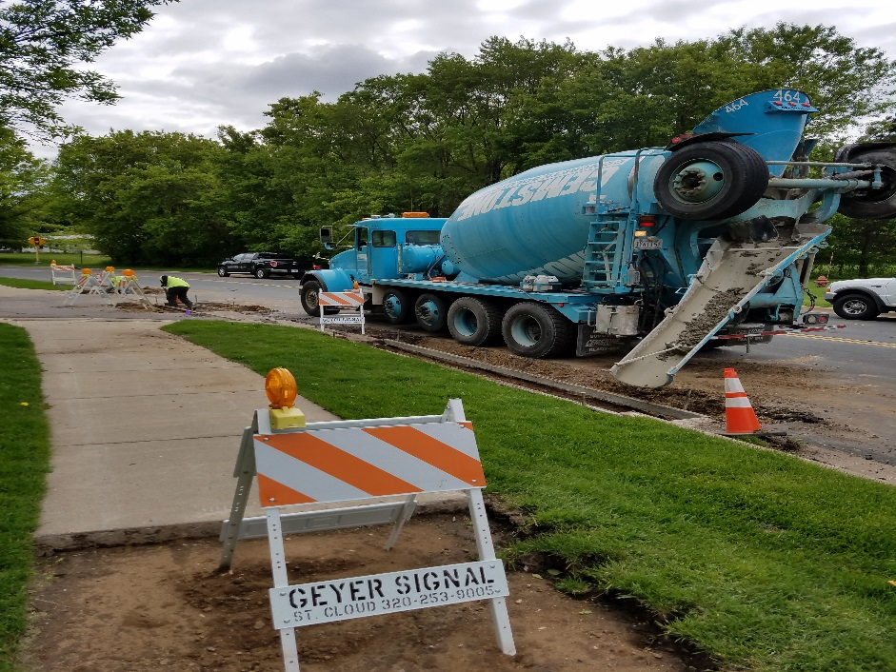
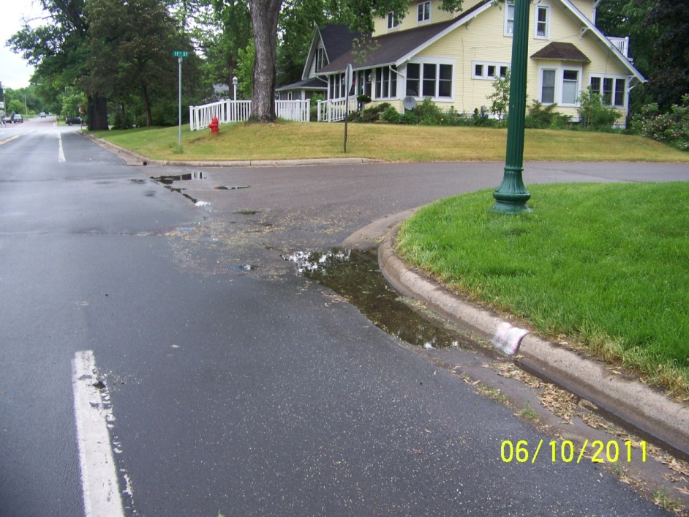
CURB REPAIRS
CURB REPAIRS
Notes:
The City’s contractor could be onsite before, during, or after gas, but typically after. The City plans on replacing some of the curb sections that are not functional. The City will also be replacing pedestrian ramps to bring them up to ADA compliance.

Slide 26
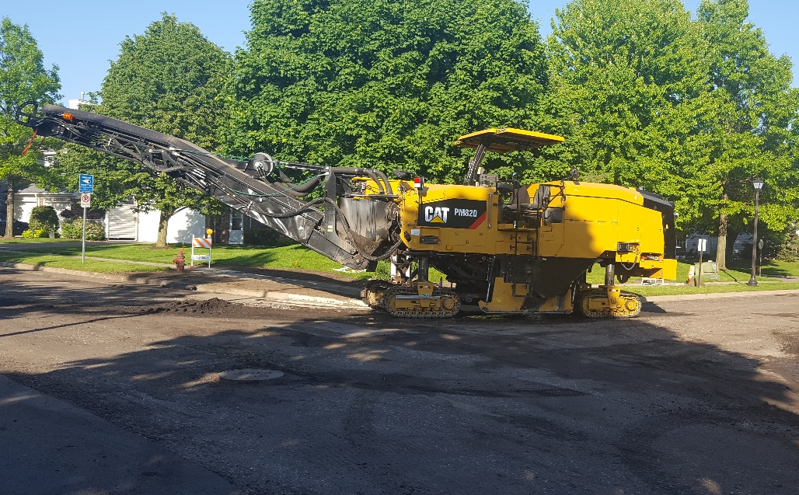
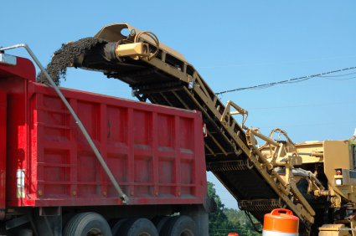
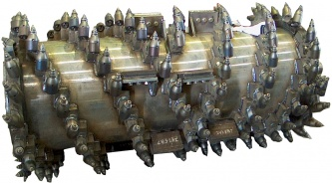
PAVEMENT REMOVAL
Notes:
After all the concrete work is done the next thing that most of you will notice is a large “mill” on site. This will grind off the top layer of bituminous (black top) for those on a Mill and Overlay Job, or the remove all of the bituminous, on a Full Pavement Replacement areas. The bottom picture is a close up of the “grinder” part of the machine with carbide teeth.

Slide 27
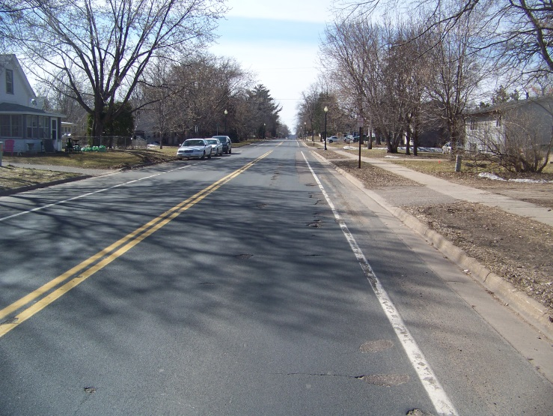
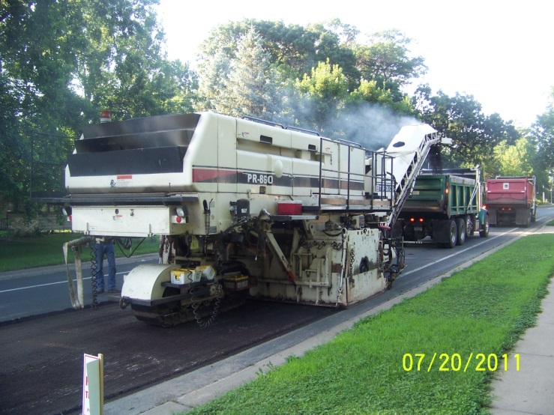
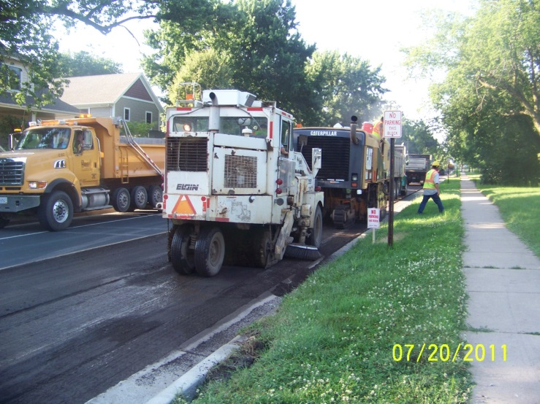
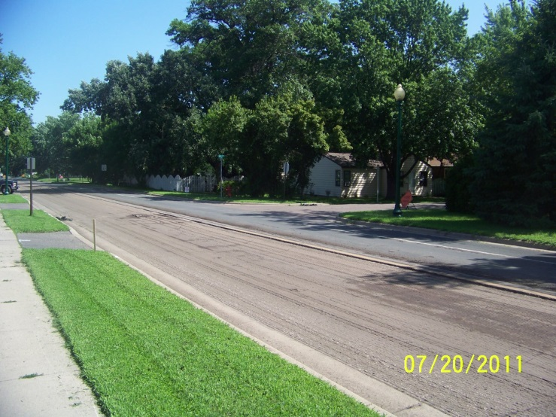
PAVEMENT REMOVAL
Notes:
More pictures of Mills. These mills, grind about an 8’ wide pass down the length of the road, then turn around and do it again, until the road is “ground down”.

Slide 28
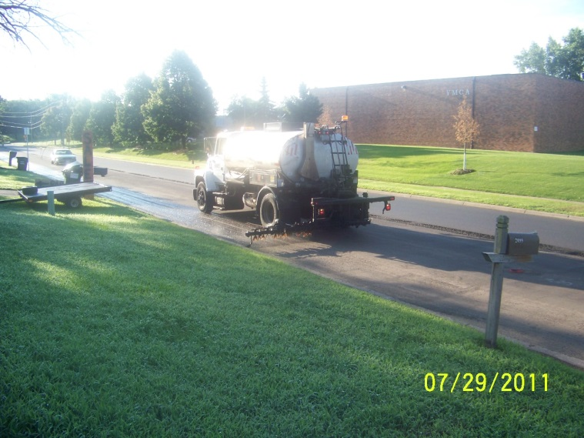
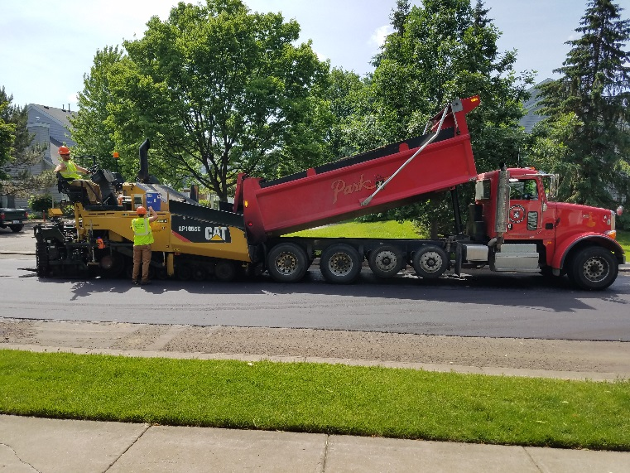
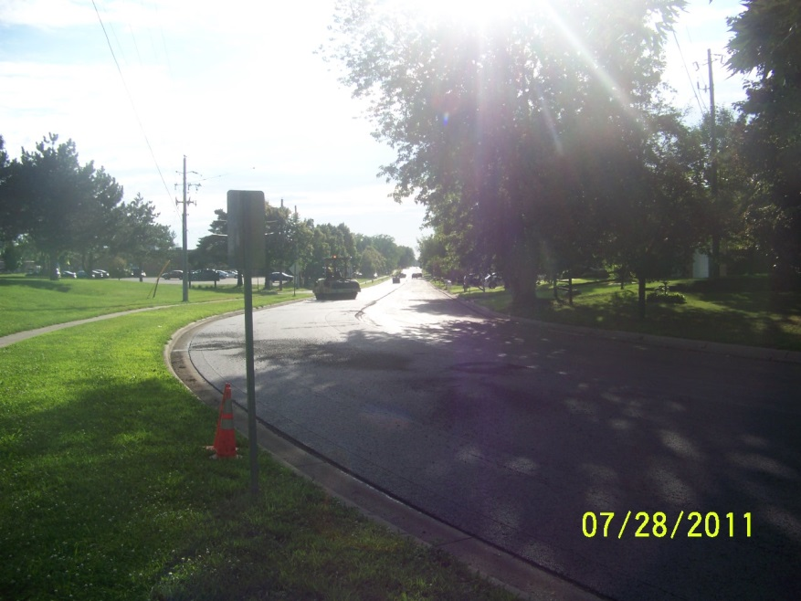
NEW PAVEMENT
Notes:
After all the roads are “milled”, the City will do base repairs as needed. Then the gate valve and man hole casting will be adjusted to the final elevation if needed. The road will be “tacked” with the sticky tack oil. Take care not to drive in it, it does track. Then the road will be paved with one lift of Bituminous. For those of you on a full pavement replacement area, we will be placing 2 lifts of bituminous. The entire process usually takes about 2 months (not counting the private utility work). The City will notify residents the day before paving as you may not have driveway access at that time. Residents will have access to their driveway about 95% of the time. Unless, we are replacing curb right in front of your driveway, we should be able to get you in and out every day. Weekend work is rare but does happen, we will let you know in advance. Typical working hours are 7 a.m. – 9 p.m., Monday – Friday.

Slide 29
WHO TO CALL
City of White Bear Lake Engineering Department | (651) 429-8531
City of White Bear Lake Police Non-Emergency | (651) 429-8511
City of White Bear Lake Utility Billing Clerk | (651) 429-8565
Xcel Energy | (800) 895-2999
White Bear Lake Post Office | (651) 762-1437
Notes:
Please call any of these phone numbers if you have any questions.

Slide 30
THANK YOU!
Thank you for taking the time to view this presentation. We hope it helps you to understand the process and what to expect during the entire pavement restoration project.
We look forward to serving you in the 2021 construction season.
~ The White Bear Lake Engineering Department

